Slide 1
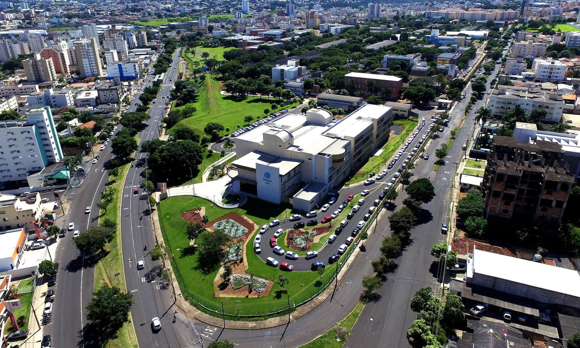

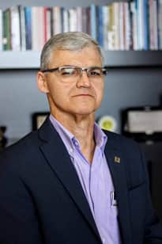
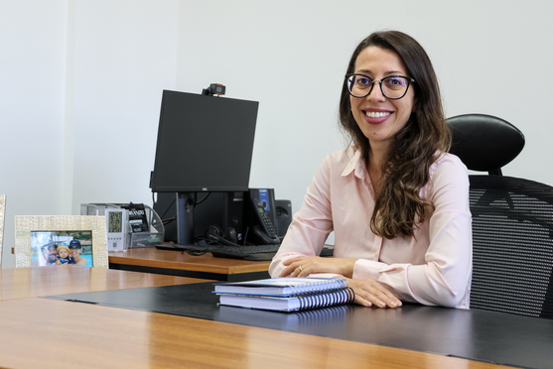
WELCOME TO UFU
RECTOR
Prof. Dr. Carlos Henrique de Carvalho
VICE -RECTOR
Profª. Dra. Catarina Machado Azeredo

Slide 2
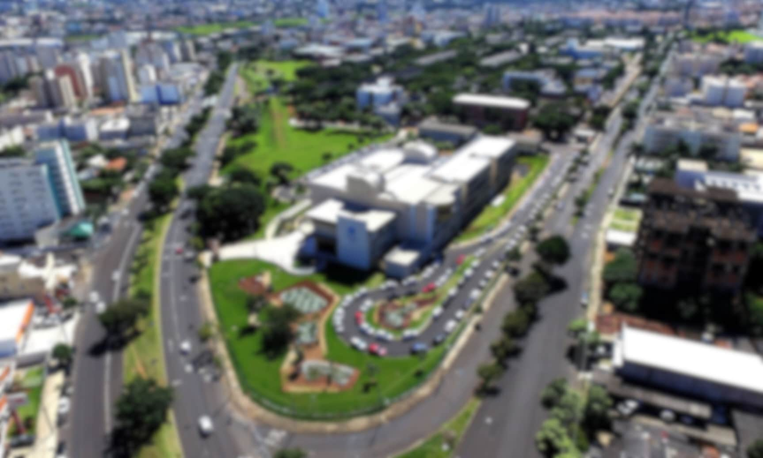





About UFU
Founded in 1978
Tuition-free
Public

Slide 3
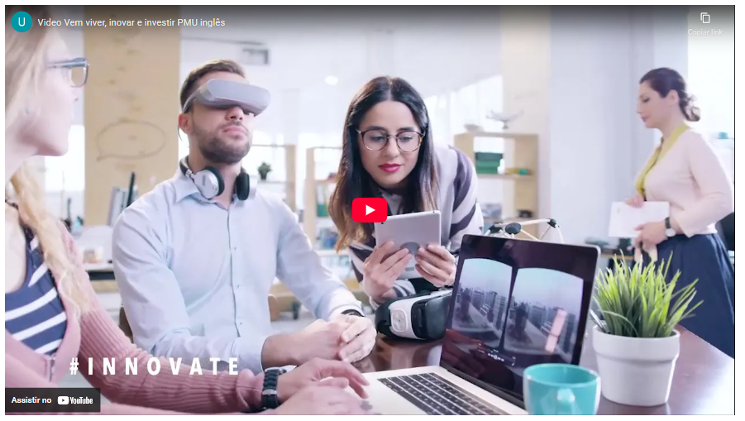
Get to know Uberlândia
www.youtube.com/watch?v=mLvM_WXJk0I

Slide 4
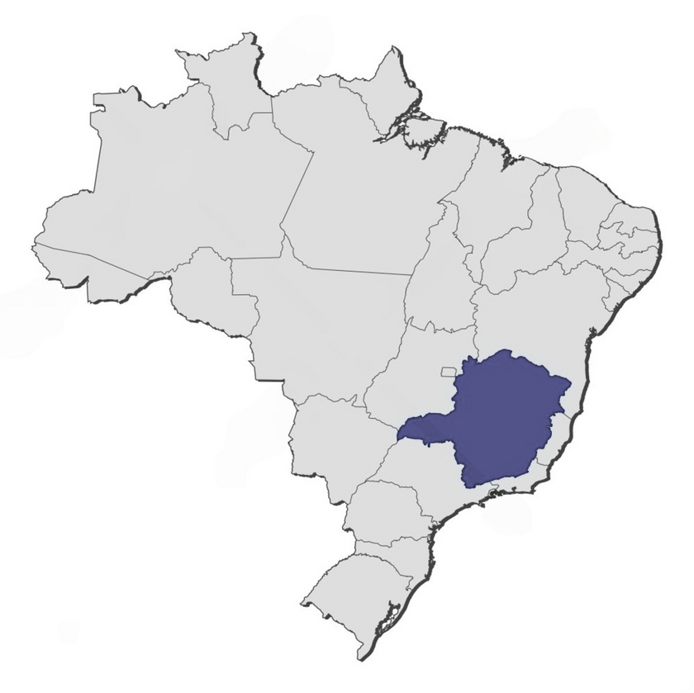

Get to know Uberlândia
4th best city to live in Brazil
UBERLÂNDIA
4th highest GDP: inland cities in Brazil
Among the world's 100 greenest cities

Slide 5
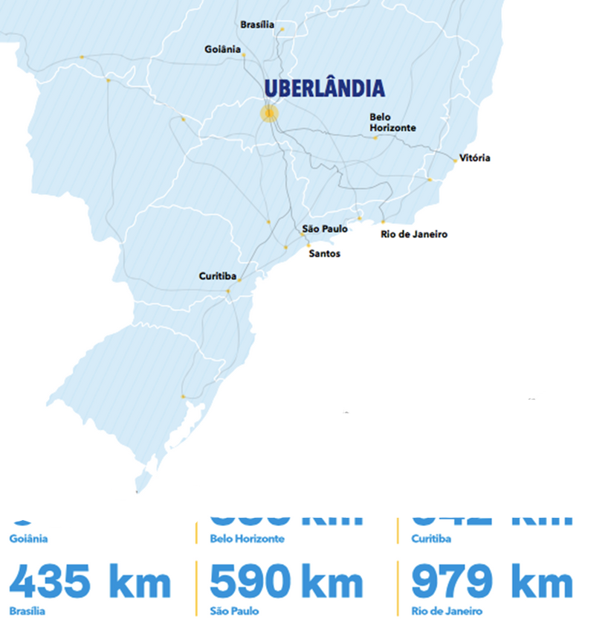
2nd largest city in MG
1st in basic sanitation in MG
2nd city in MG in number of startups
University hub: 2 public (UFU and IFTM) and various private universities

Slide 6
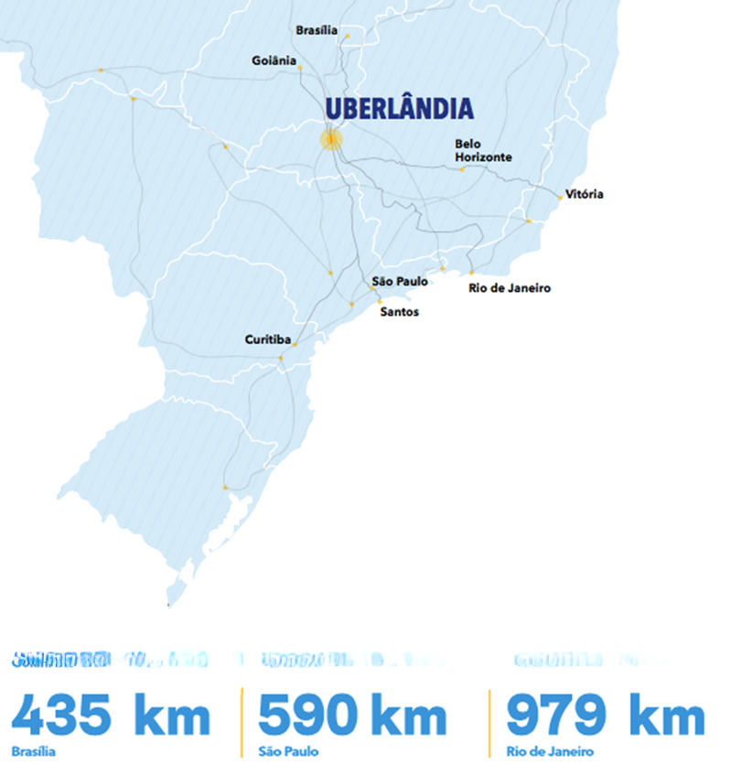
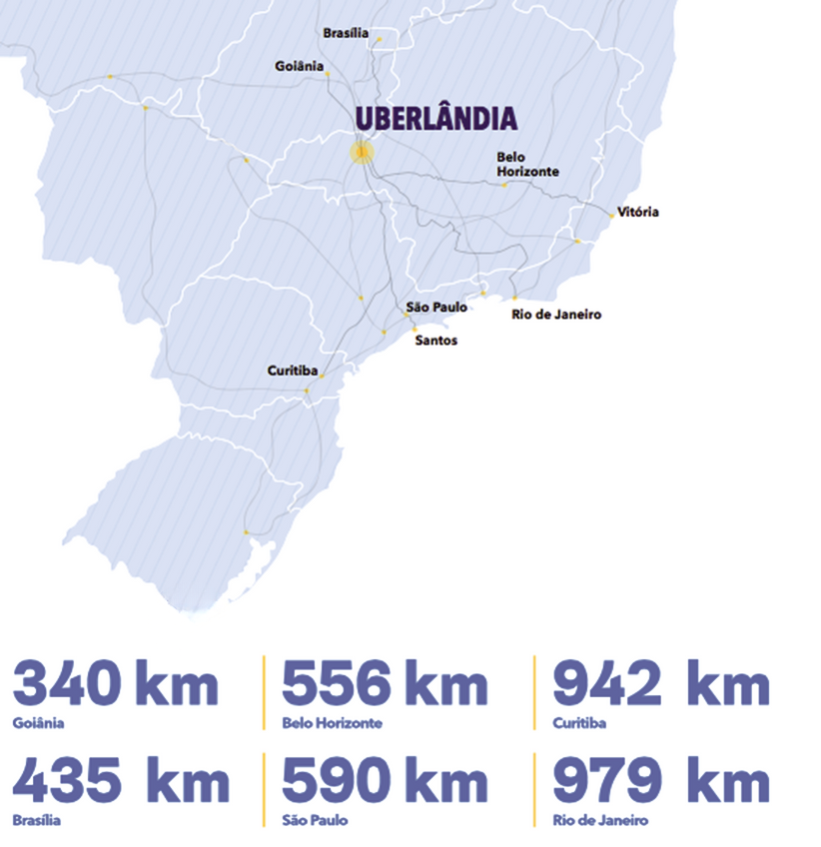
Local airport
Zero-fare bus for students
Average temperature: 23°C
Easy acces to main highways

Slide 7

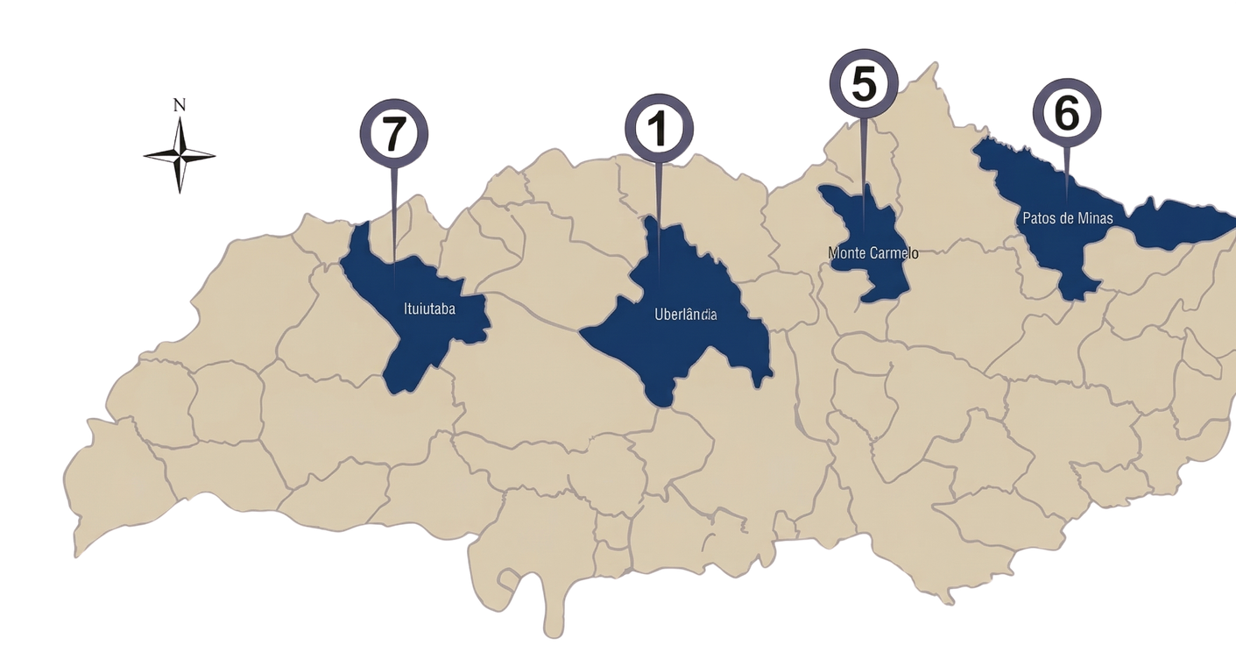
1
Educação Física
2
Our campi
3
Santa Mônica
4
Umuarama
1
Santa Mônica
5
Monte Carmelo
2
Glória
6
Patos de Minas
3
Educação Física
7
Pontal
4
Umuarama
7

Slide 8

Open-air Facilities
Glória
(685 hectares)
Capim Branco
(373 hectares)
Água Limpa
(670 hectares)
Reserva Ecológica do Panga
(+400 hectares)

Slide 9
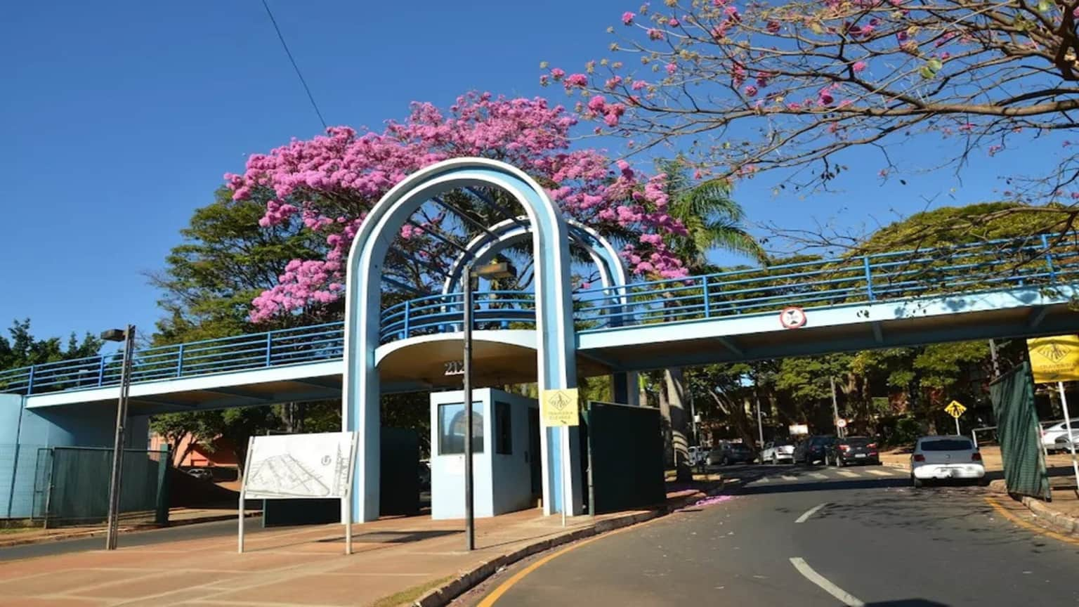
Get to know our institution

Slide 10

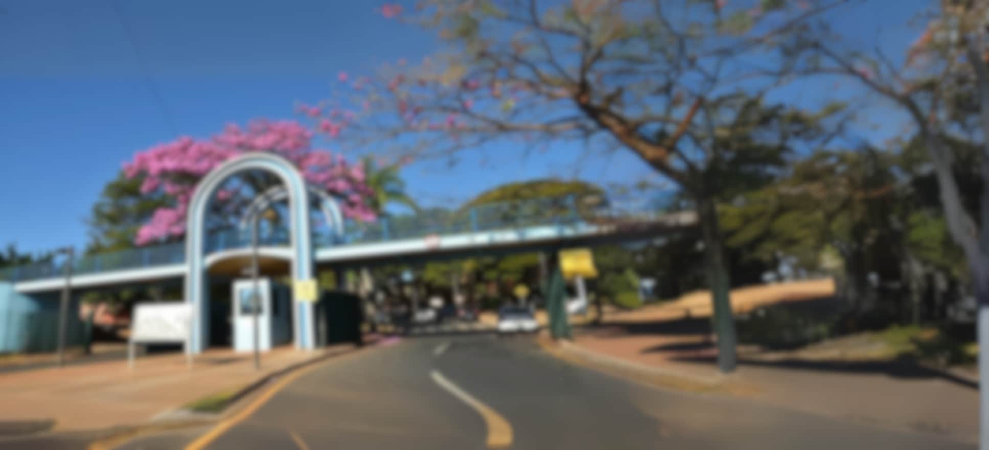





Our levels of education
Primary & Basic Education
Technical & Vocational Training
Graduate & Post-Graduate Studies
Undergraduate Programs
ESEBA
ESTES
- Teaching Degrees
- Bachelor's Degrees
- Specialization
- Master's Degree
- Ph.D.
eseba.ufu.br
estes.ufu.br
prograd.ufu.br
ufu.br/pos-graduacao

Slide 11




Our institutional numbers
+35k
+28k
+2k
+3k
+35.000 people
+28.000 enrolled students
+2.000 professors
( >90% PhD)
+3.000 staff

Slide 12
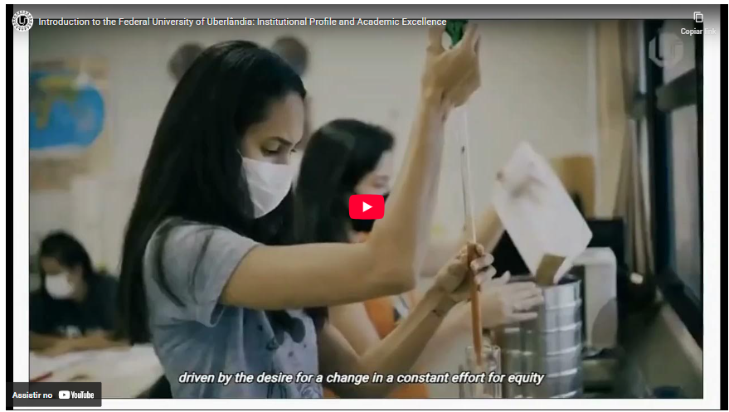
Get to know UFU
youtube.com/watch?v=0sSN29KHzY4

Slide 13
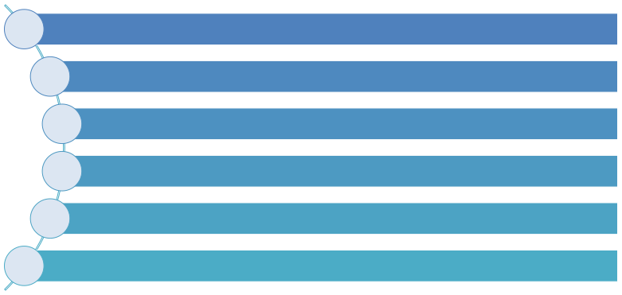






Our institution
99 undergraduate degree programs
31 PhD degrees
42 academic Master’s degrees
12 professional Master’s degrees
44 specialization courses
+50 opportunities for distance education

Slide 14





Distance Education
20 distance education programs
5 undergraduate degree courses
6 post-graduated specialization courses
1 outreach and extension courses
8 refresher courses
Moodle as a learning platform

Slide 15

Our general areas of knowledge
Biological Sciences
Languages and Arts
Medical and Health Sciences
Mathematical and Natural Sciences
General Areas of Knowledge
Engineering and Computing
Socially Applied Sciences
Agronomic and Veterinary Sciences
Multidisciplinary: Engineering
Multidisciplinary: Technology/
Management
Human Sciences

Slide 16
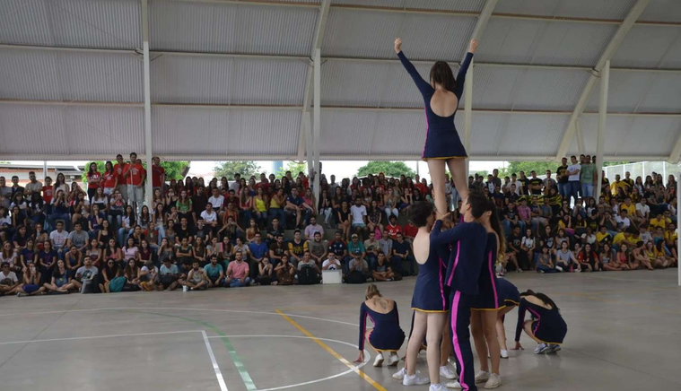
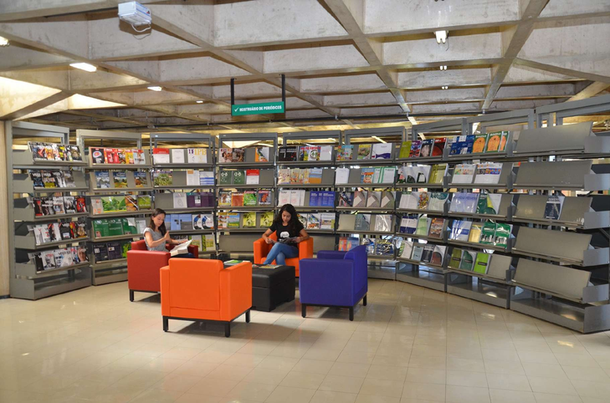
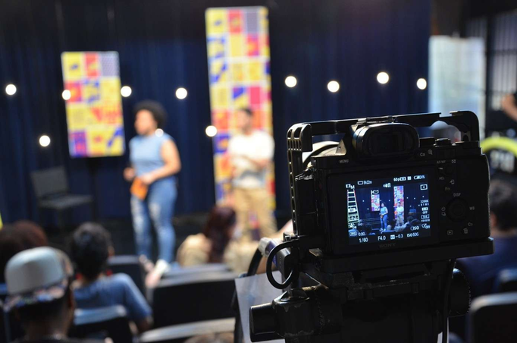

Adittional Numbers
6 Sports Centers
9 libraries
1 TV Station
1 FM Radio Station

Slide 17
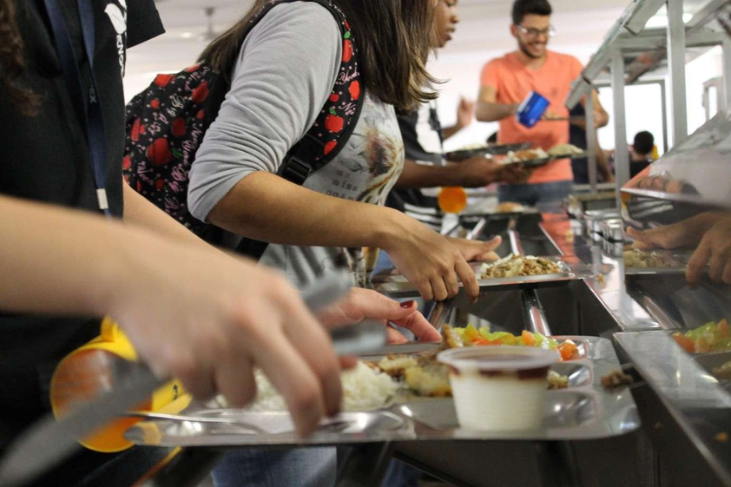

University Restaurants
5 University Restaurants
Meals every day

Slide 18
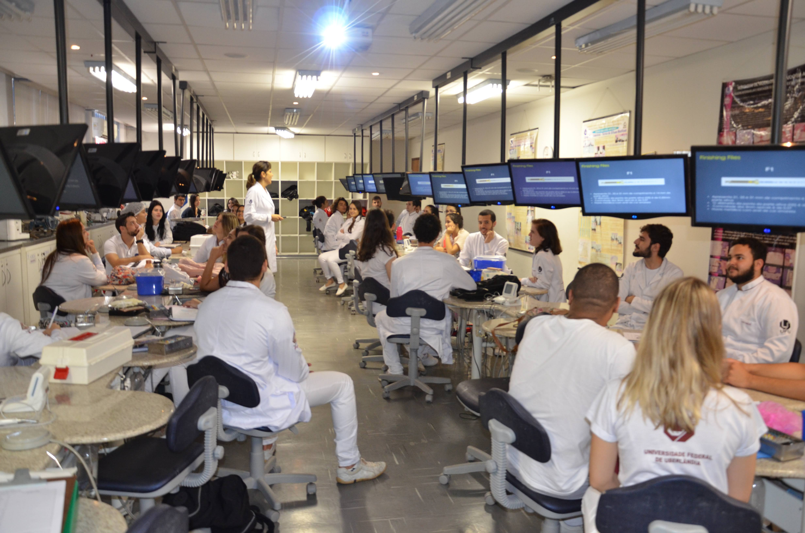
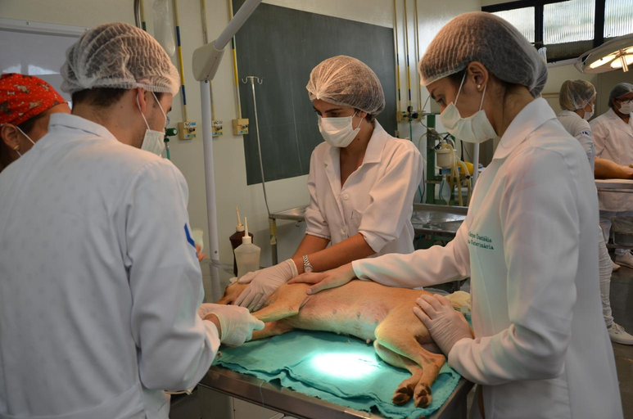
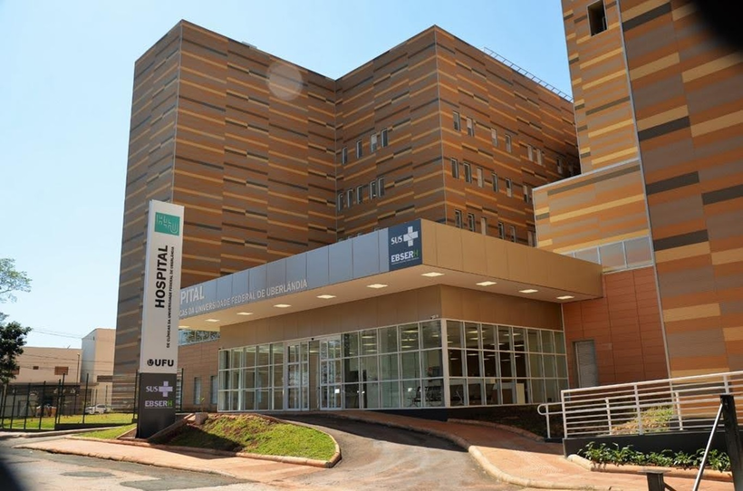
Adittional Numbers
3 university hospitals

Slide 19
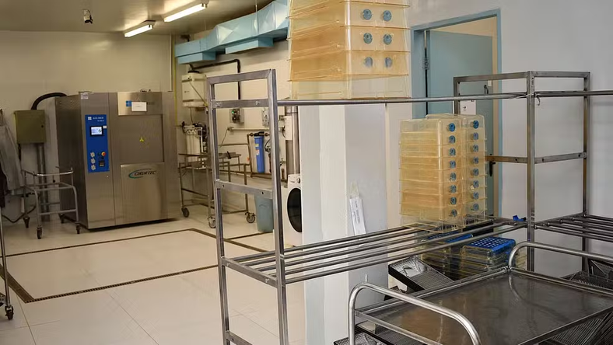


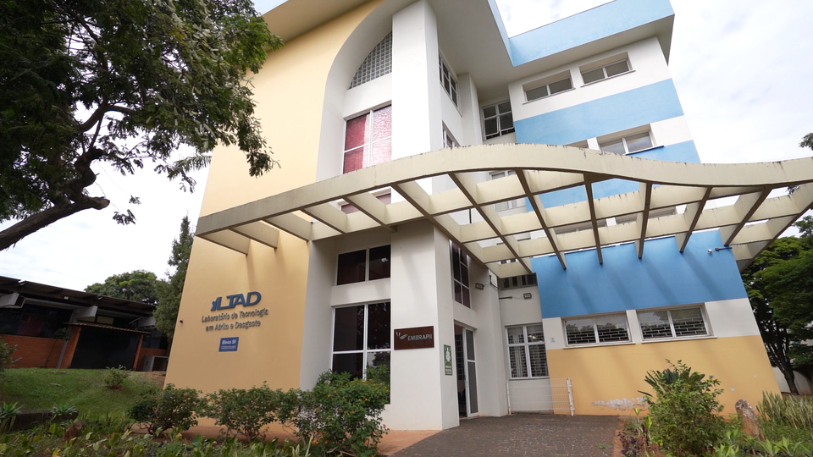
Labs
NBA3
LTAD

Slide 20
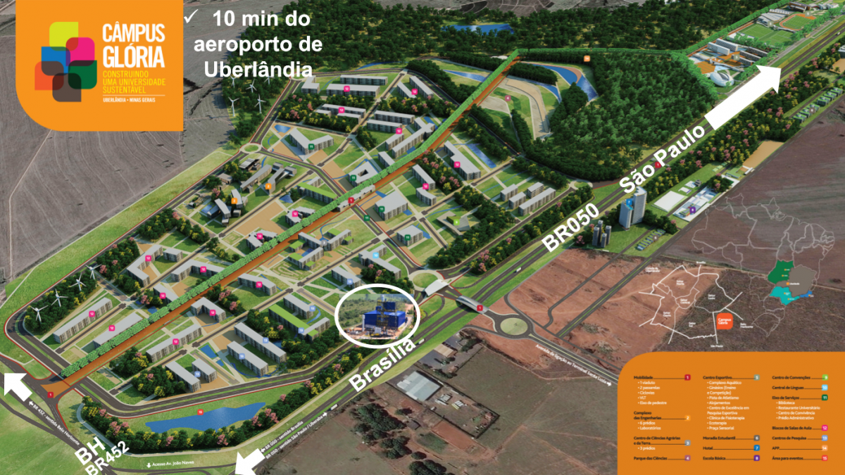
Technology Park
Thermochemistry Laboratory
EMBRAPII: Brazilian Industrial Research and Innovation Company

Slide 21
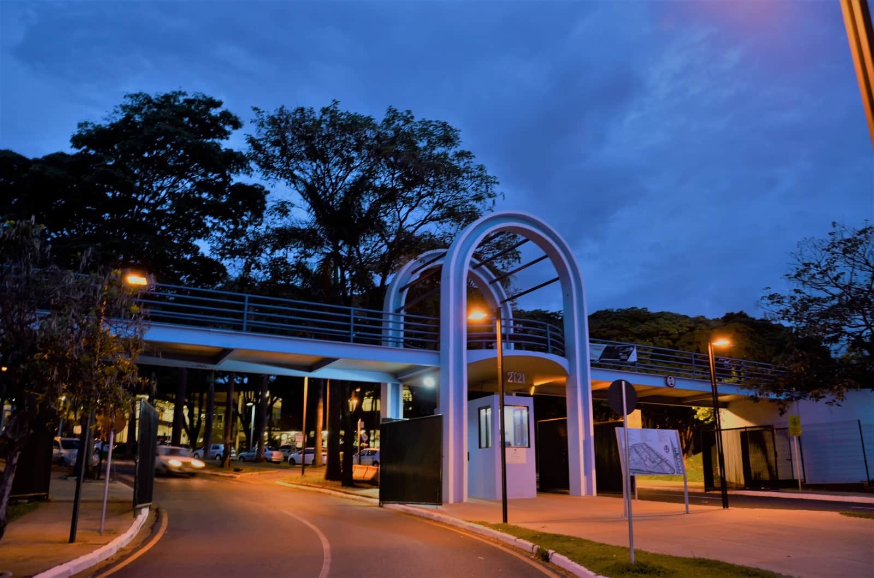
Get to know our international affairs office

Slide 22
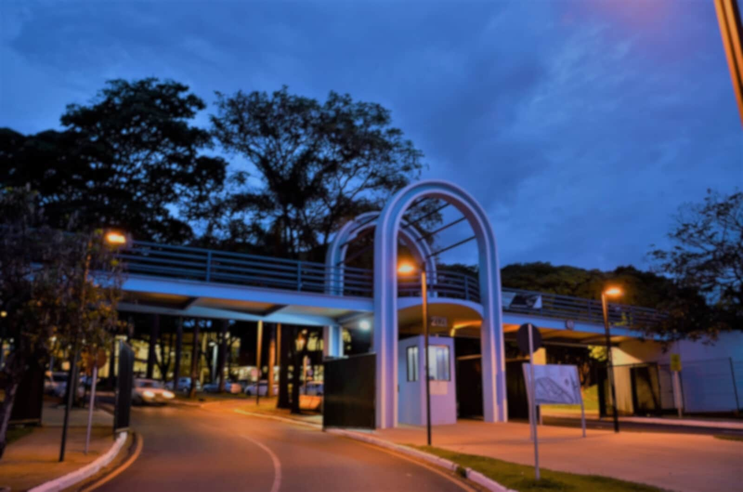






Our International numbers
+2k
+1k
+40
+210
+10
+10
+2.000 outgoing students
+1.000
incoming students
+40 international servants
+210 partner
universities
+10 international programs
+10 dual degree options

Slide 23
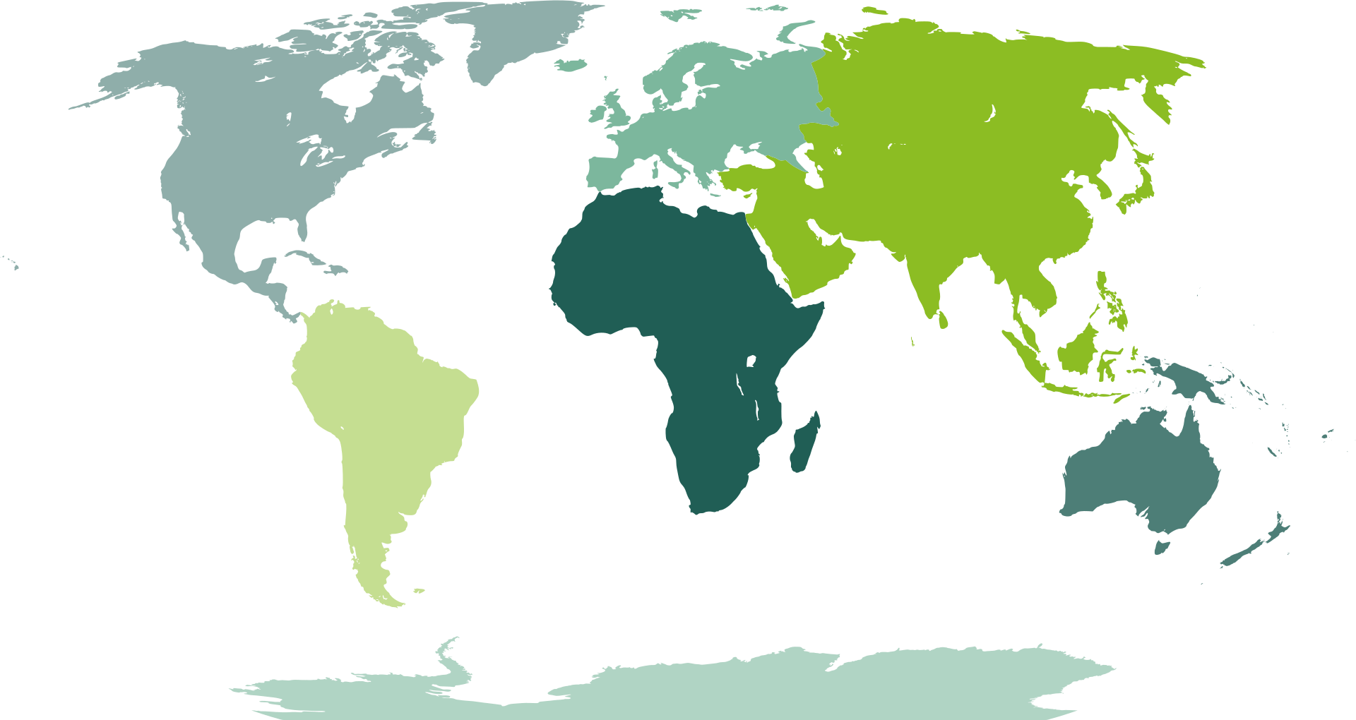





Our bilateral agreement numbers
By continent
Partner
Institutions
Partner
Institutions
151
Partner
Institutions
20
17
Partner
Institutions
3
Partner
Institutions
5
Partner
Institutions
33
Partner
Institutions
1

Slide 24







International Associations and Networks

Slide 25




National Associations and Networks
focused on internationalization

Slide 26



Academic Support and Integration Programs

Slide 27




Programs to Support University Internationalization in Brazil
CAPES Print
2018
FAPEMIG Internacional
2022
CAPES Global
2026
13 millions
2,5 millions
80 millions

Slide 28

How can we internationaly collaborate
Signing of MoU (Memorandum of Understanding)
Co-supervisions (Cotutelle Programs)
Mobility of students, staff, researchers, and professors
Specific Cooperation Agreement
Double Degrees

Slide 29

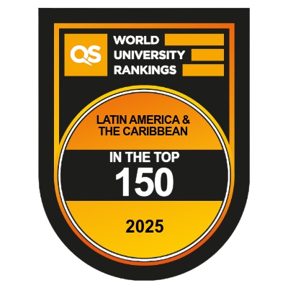
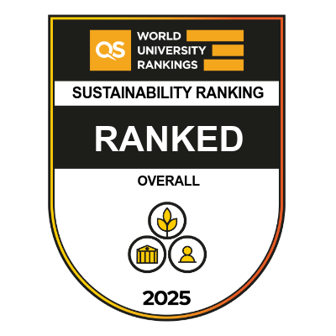
UFU at rankings

Slide 30
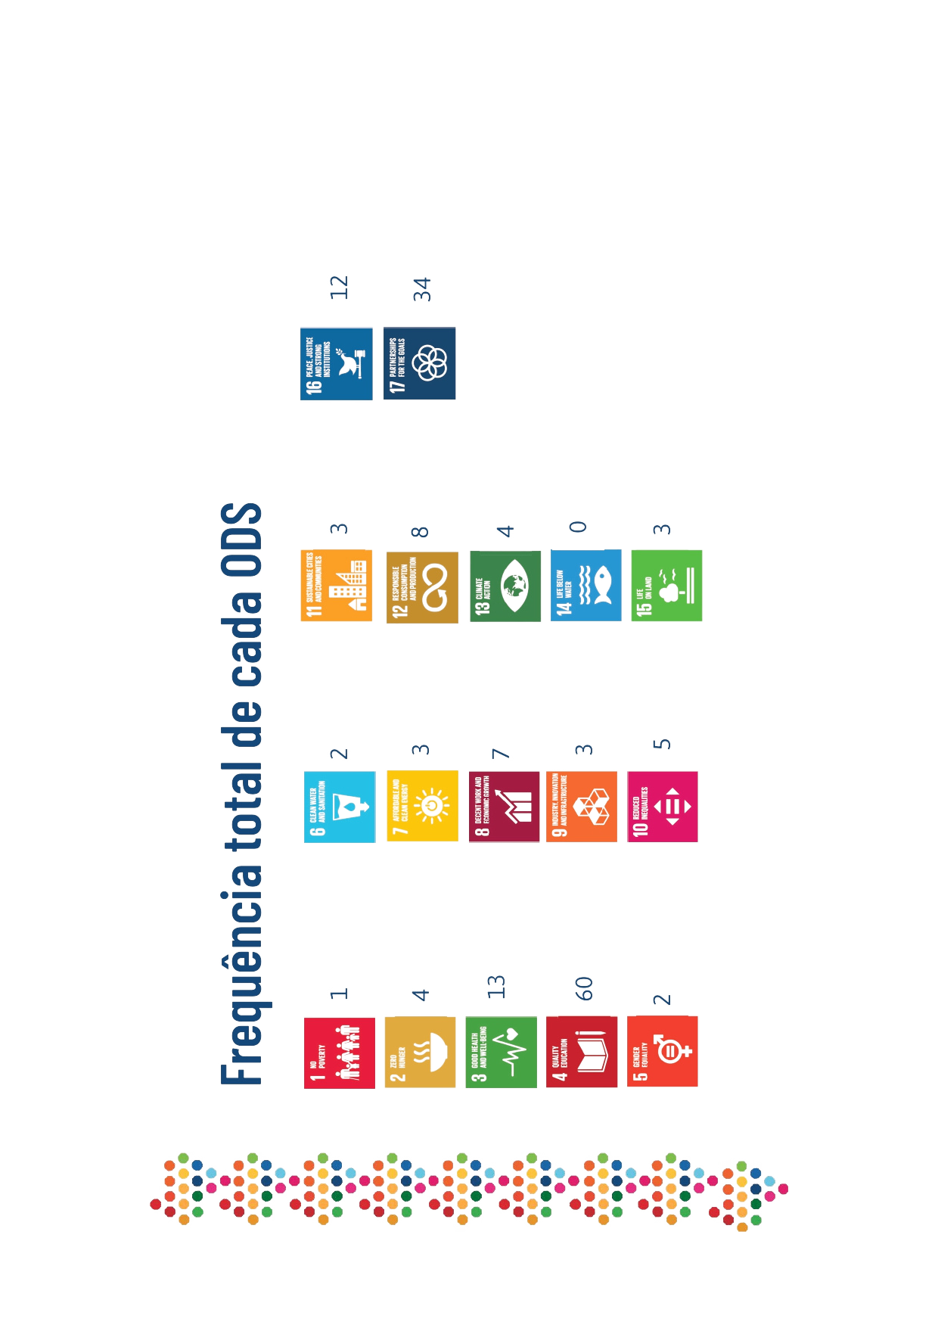

SDG progress report

Slide 31
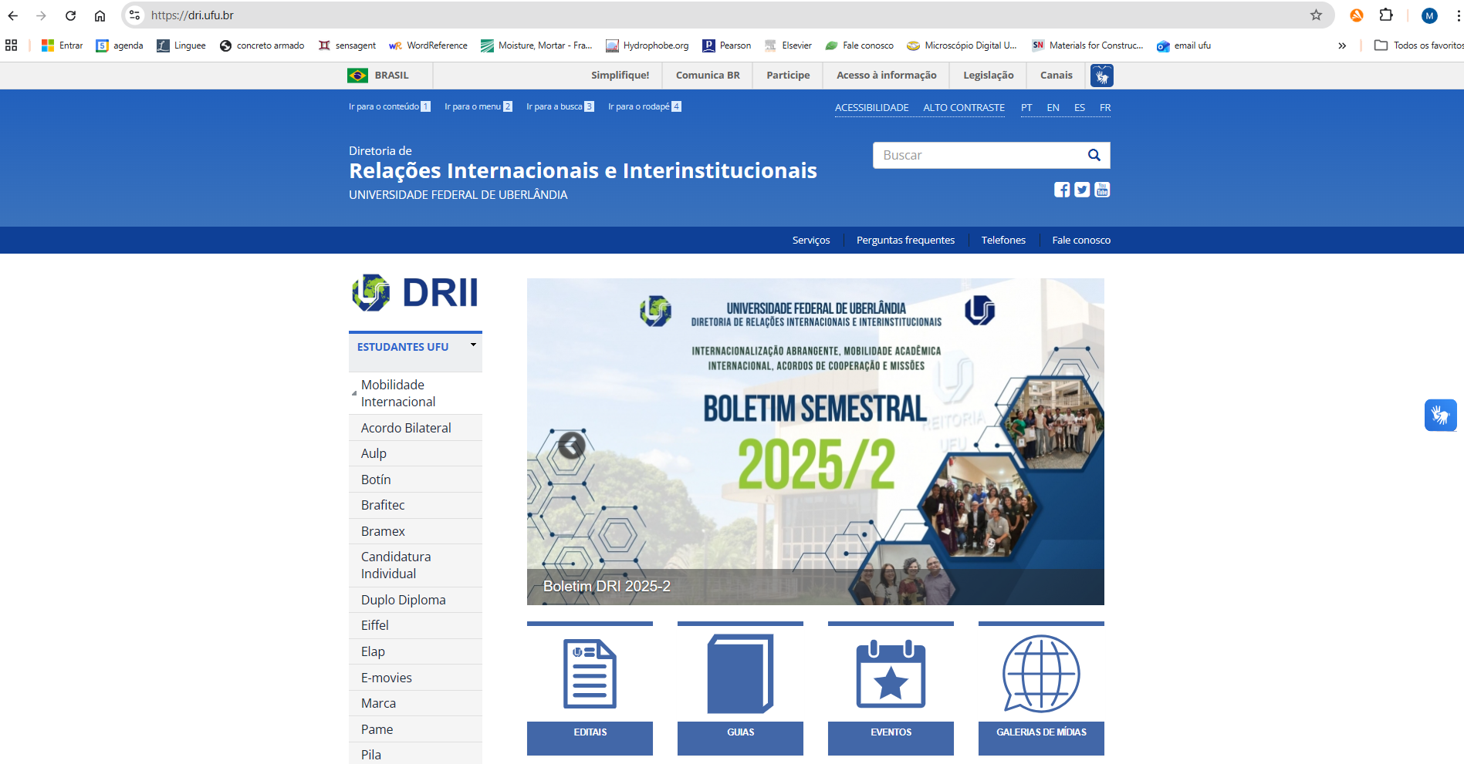
Get to know our website
dri.ufu.br

Slide 32
Thank you
Contact : international@ufu.br

