Slide 1
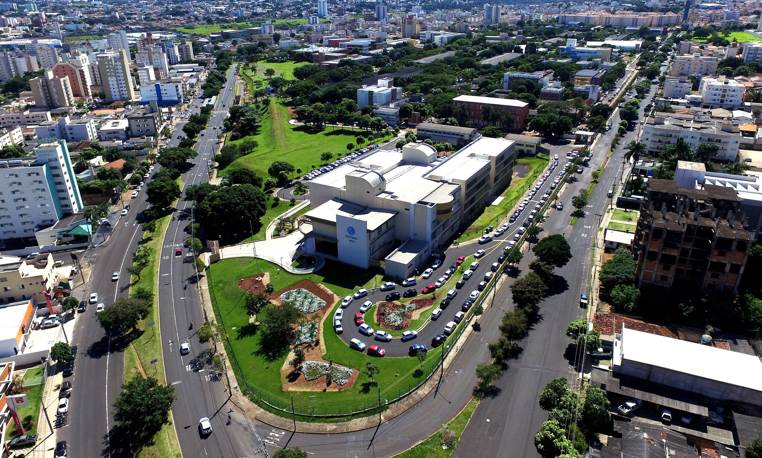

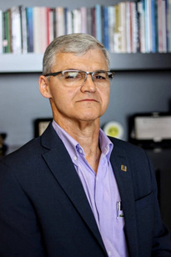

WELCOME TO UFU
RECTOR
Prof. Dr. Carlos Henrique de Carvalho
VICE -RECTOR
Profª. Dra. Catarina Machado Azeredo

Slide 2
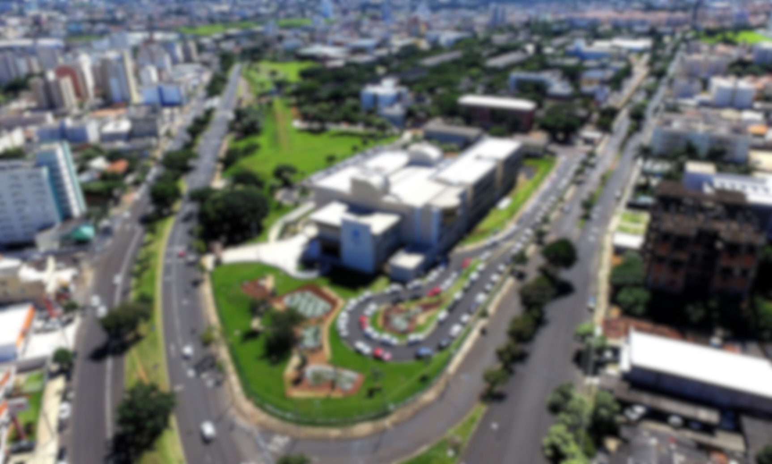





About UFU
Founded in 1978
Tuition-free
Public

Slide 3
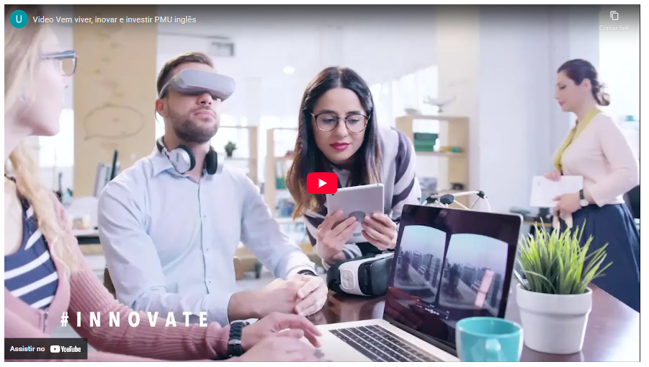
Uberlândia
www.youtube.com/watch?v=mLvM_WXJk0I

Slide 4
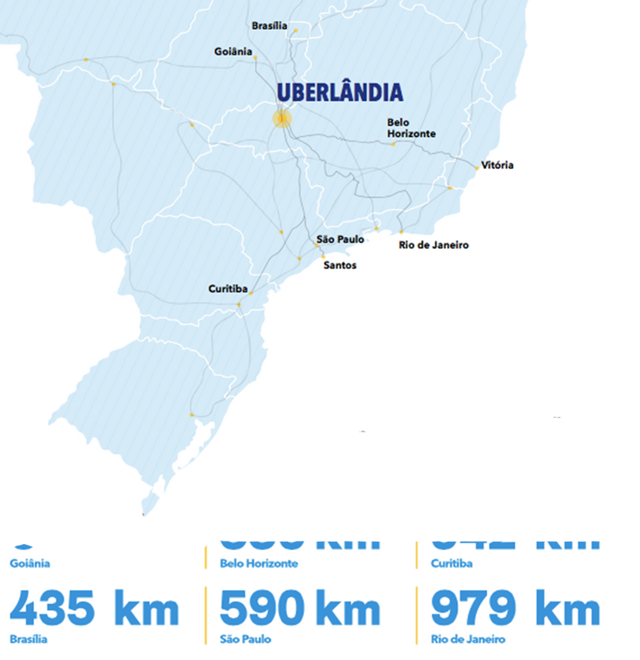
2nd largest city in MG
1st in basic sanitation in MG
2nd city in MG in number of startups
4th highest GDP: inland cities in Brazil
Among the world's 100 greenest cities
University hub: 2 public (UFU and IFTM) and various private universities

Slide 5
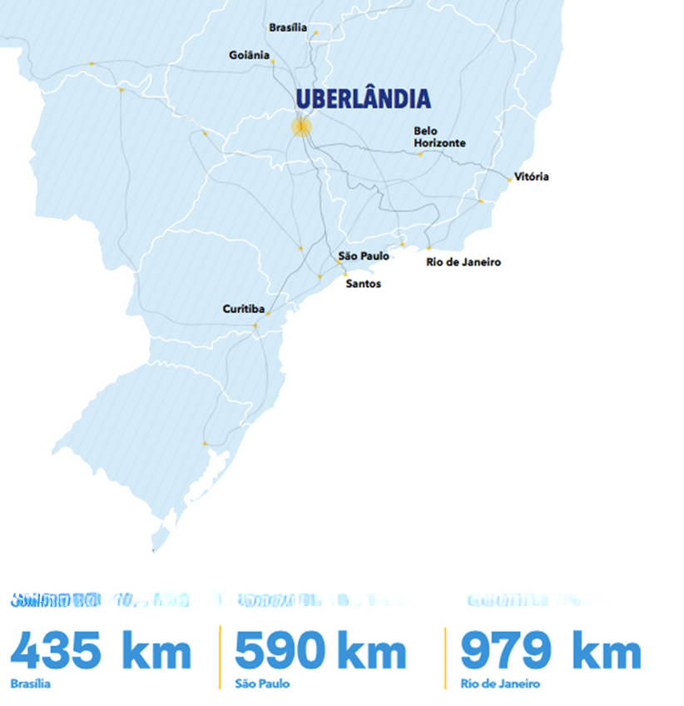
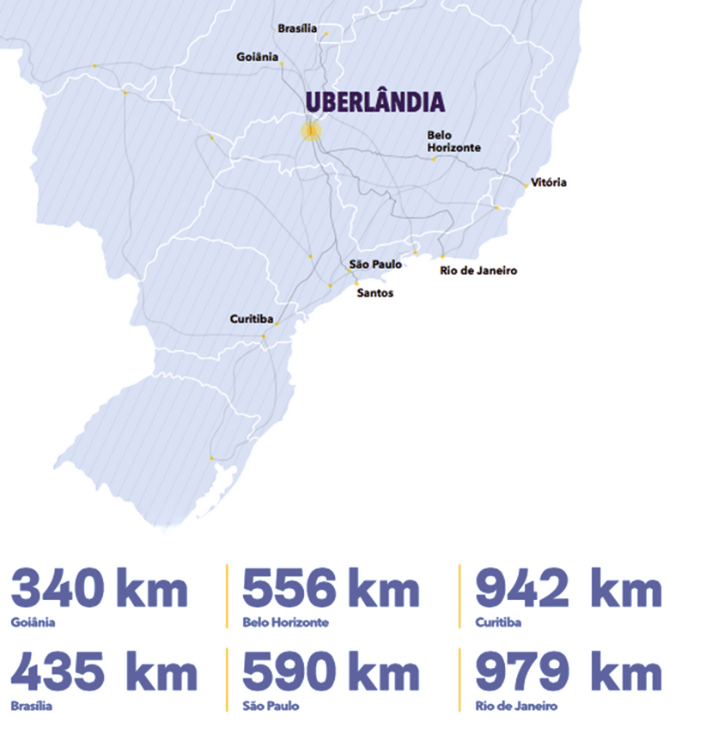
Local airport
Zero-fare bus for students
Average temperature: 23°C
Easy acces to main highways

Slide 6
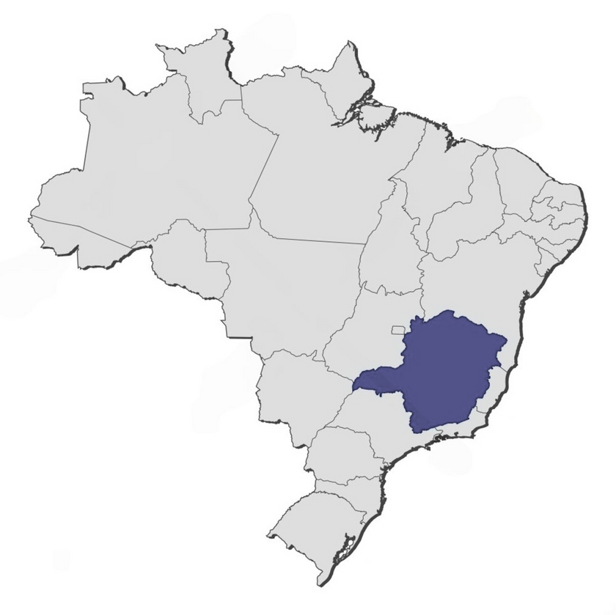




Our campi
1
Educação Física
2
Glória
3
Santa Mônica
UBERLÂNDIA
4
Umuarama
5
Monte Carmelo
6
Patos de Minas
7
Pontal

Slide 7

Open-air Facilities
Glória
(685 hectares)
Capim Branco
(373 hectares)
Água Limpa
(670 hectares)
Reserva Ecológica do Panga
(+400 hectares)

Slide 8
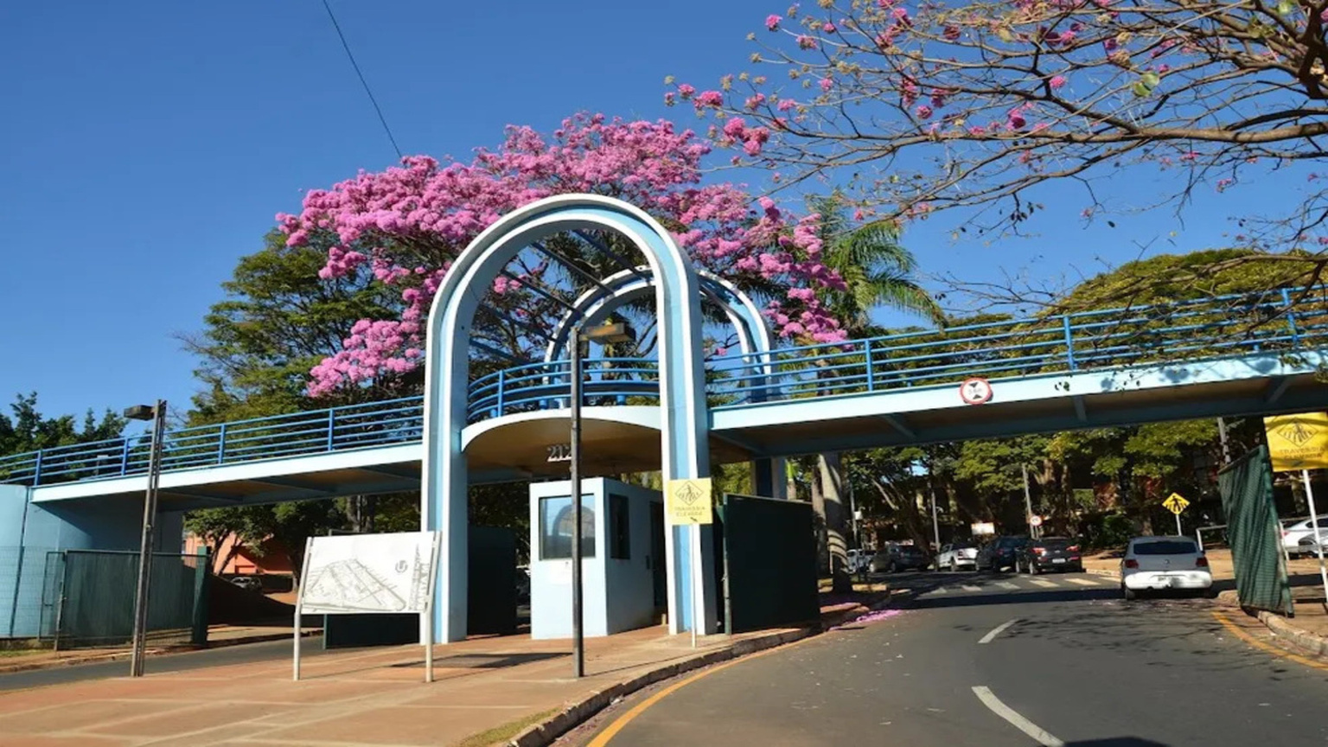
Get to know our institution

Slide 9

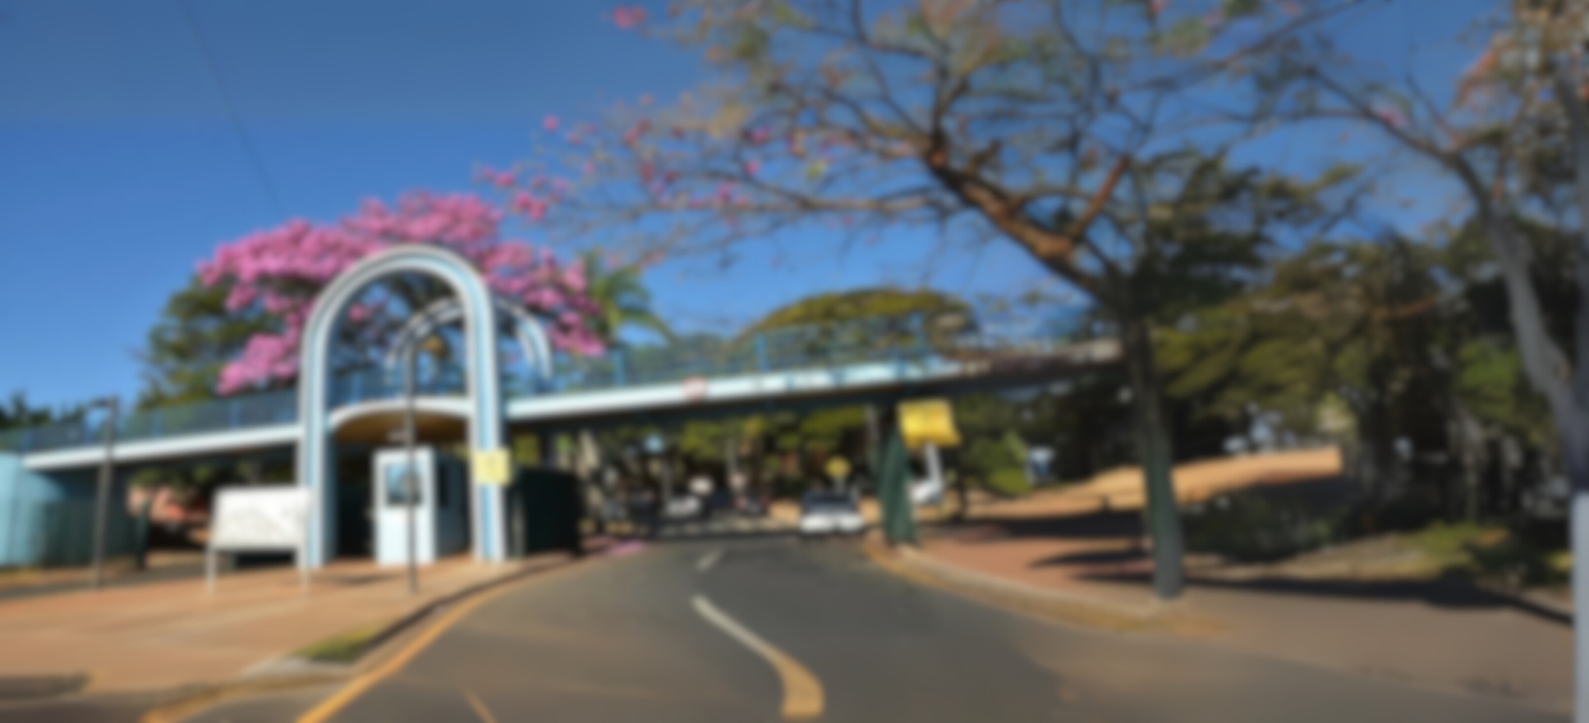





Our levels of education
Primary & Basic Education
Technical & Vocational Training
Graduate & Post-Graduate Studies
Undergraduate Programs
ESEBA
ESTES
- Teaching Degrees
- Bachelor's Degrees
- Specialization
- Master's Degree
- Ph.D.
eseba.ufu.br
estes.ufu.br
prograd.ufu.br
ufu.br/pos-graduacao

Slide 10




Our institutional numbers
+35k
+28k
+2k
+3k
+35.000 people
+28.000 enrolled students
+2.000 professors
( >90% PhD)
+3.000 staff

Slide 11
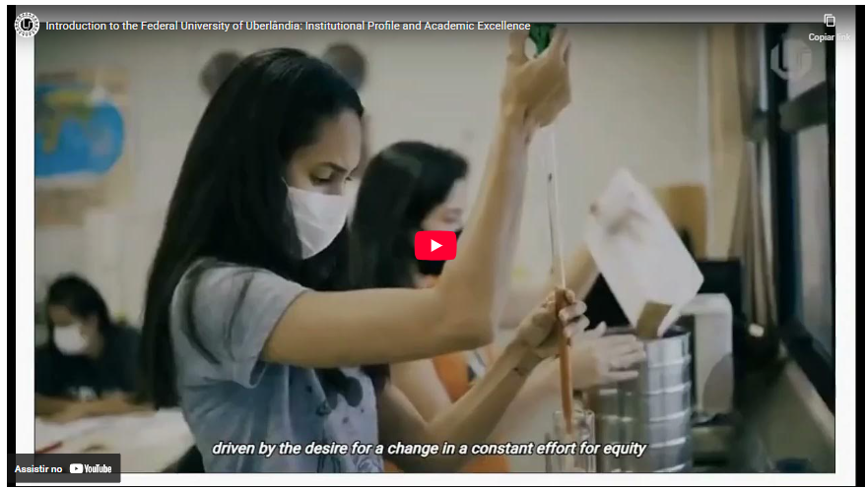
Get to know UFU
youtube.com/watch?v=0sSN29KHzY4

Slide 12
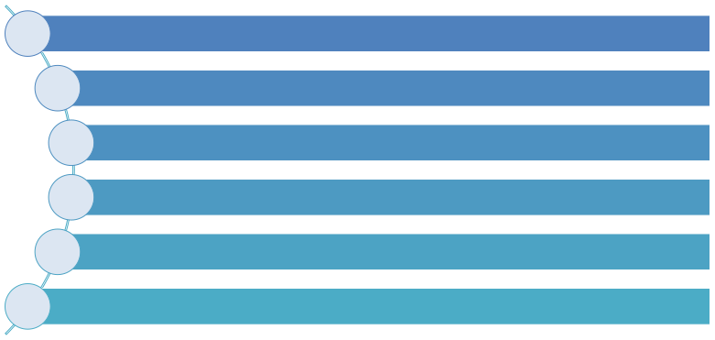






Our institution
99 undergraduate degree programs
31 PhD degrees
42 academic Master’s degrees
12 professional Master’s degrees
44 specialization courses
+50 opportunities for distance education

Slide 13





Distance Education
20 distance education programs
5 undergraduate degree courses
6 post-graduated specialization courses
1 outreach and extension courses
8 refresher courses
Moodle as a learning platform

Slide 14

Our general areas of knowledge
Biological Sciences
Languages and Arts
Medical and Health Sciences
Mathematical and Natural Sciences
General Areas of Knowledge
Engineering and Computing
Socially Applied Sciences
Agronomic and Veterinary Sciences
Multidisciplinary: Engineering
Multidisciplinary: Technology/
Management
Human Sciences

Slide 15
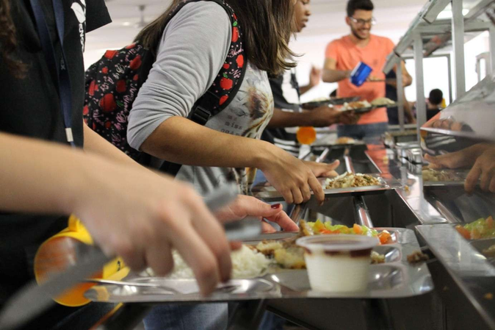
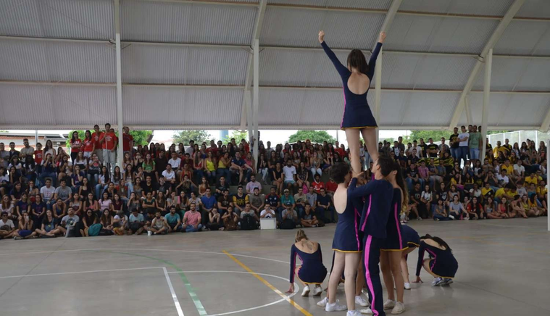
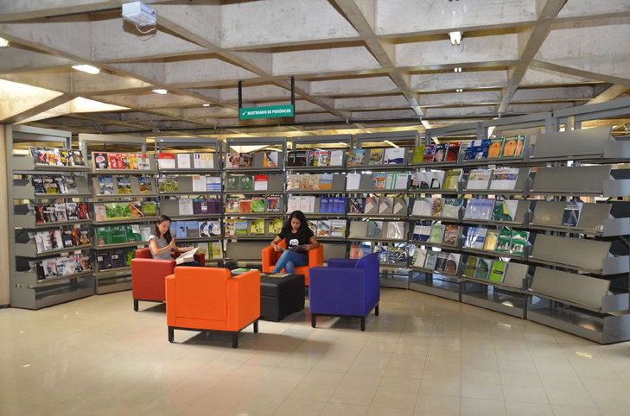


Adittional Numbers
5 University Restaurants
6 Sports Centers
9 libraries
1 TV Station
1 FM Radio Station

Slide 16
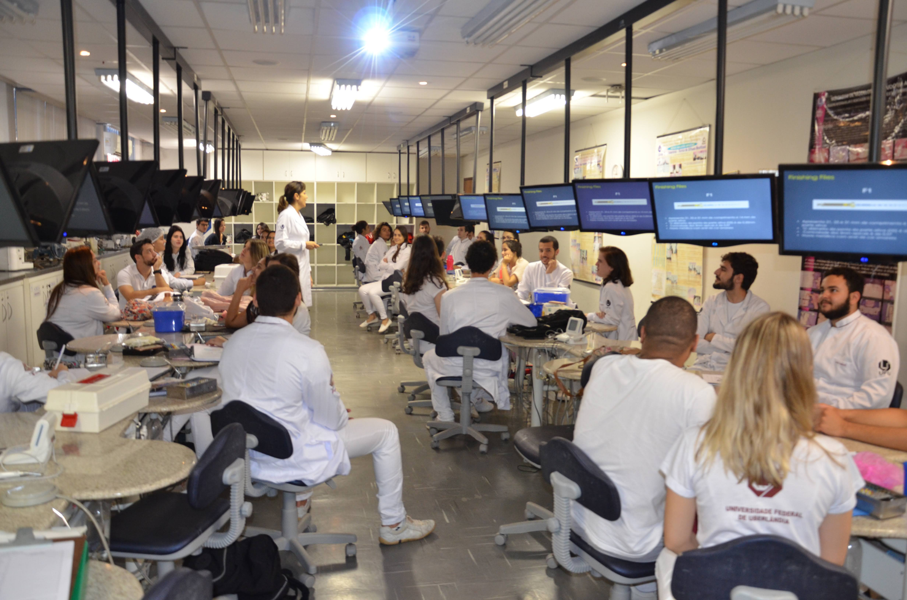
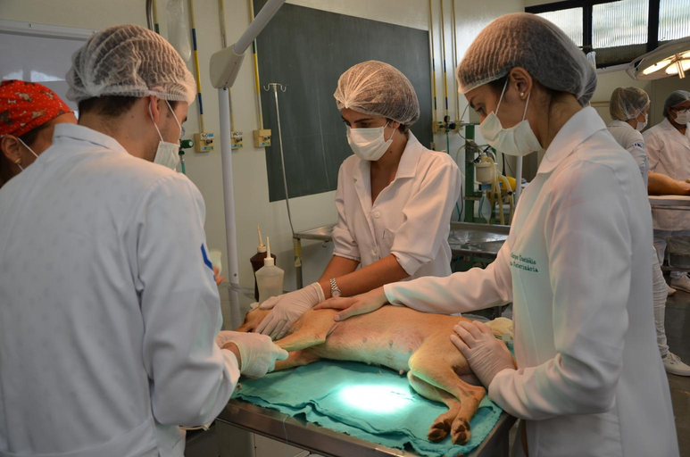
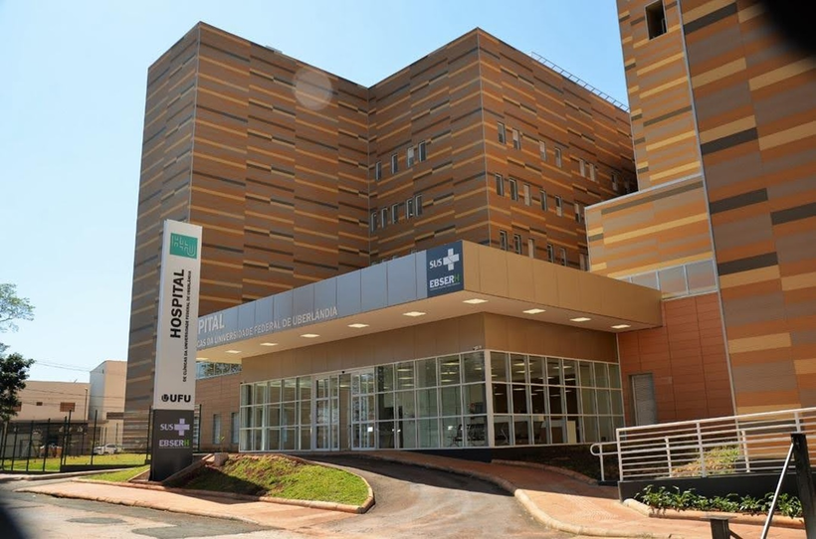
Adittional Numbers
3 university hospitals

Slide 17
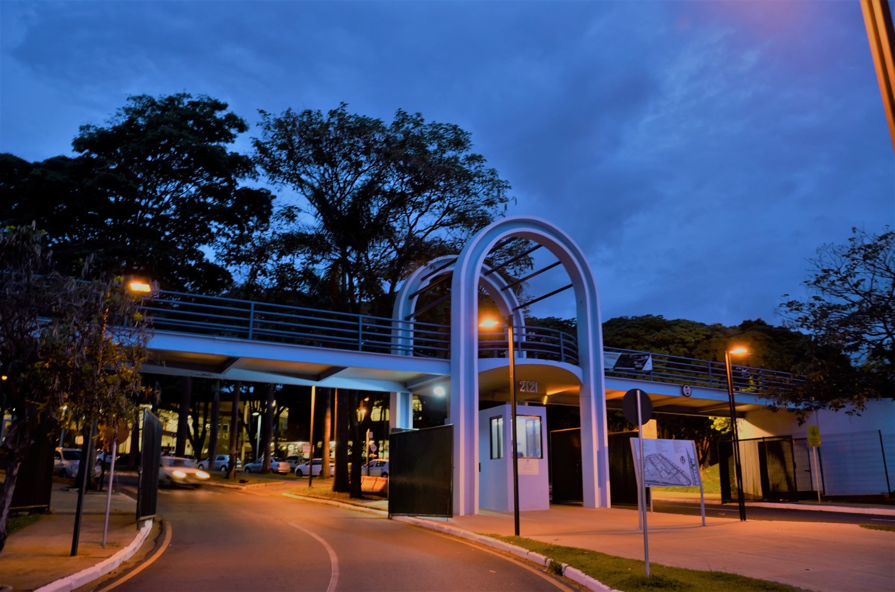
Get to know our international affairs office

Slide 18
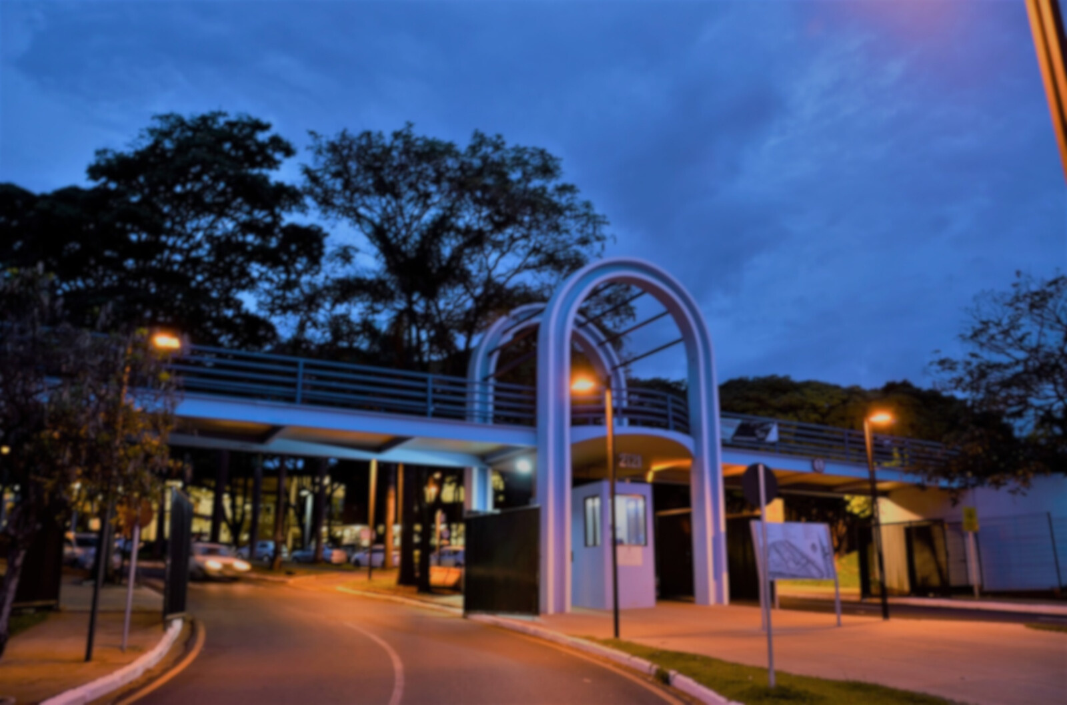






Our International numbers
+2k
+1k
+40
+210
+10
+10
+2.000 outgoing students
+1.000
incoming students
+40 international servants
+210 partner
universities
+10 international programs
+10 dual degree options

Slide 19
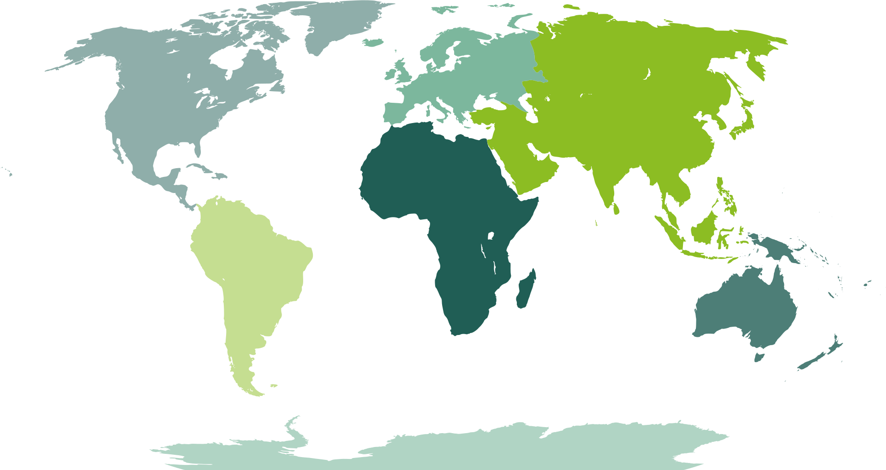





Our bilateral agreement numbers
By continent
Partner
Instituitons
Partner
Instituitons
151
Partner
Instituitons
20
17
Partner
Instituitons
3
Partner
Instituitons
5
Partner
Instituitons
33

Slide 20







International Associations and Networks

Slide 21




National Associations and Networks
focused on internationalization

Slide 22

How can we internationaly collaborate
Signing of MoU (Memorandum of Understanding)
Co-supervisions (Cotutelle Programs)
Mobility of students, staff, researchers, and professors
Specific Cooperation Agreement
Double Degrees

Slide 23

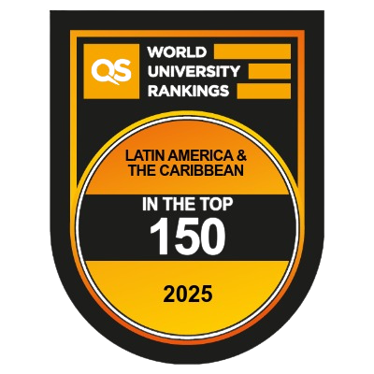

UFU at rankings

Slide 24
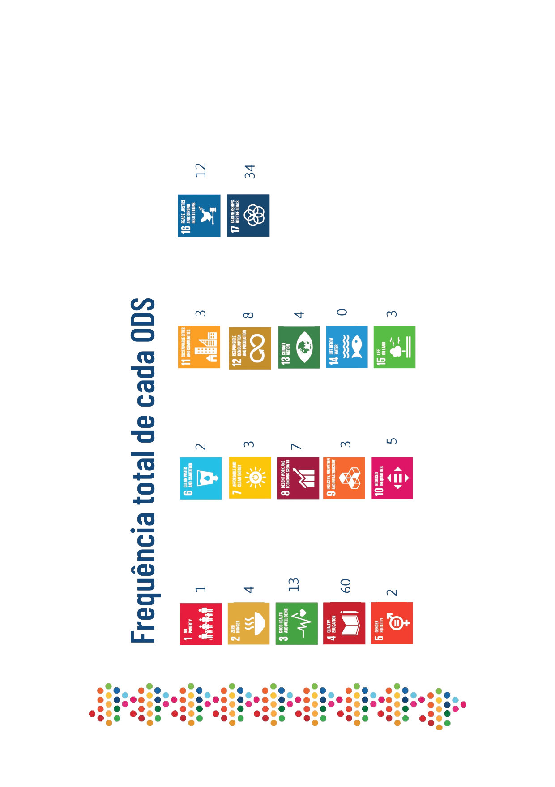

SDG progress report

Slide 25
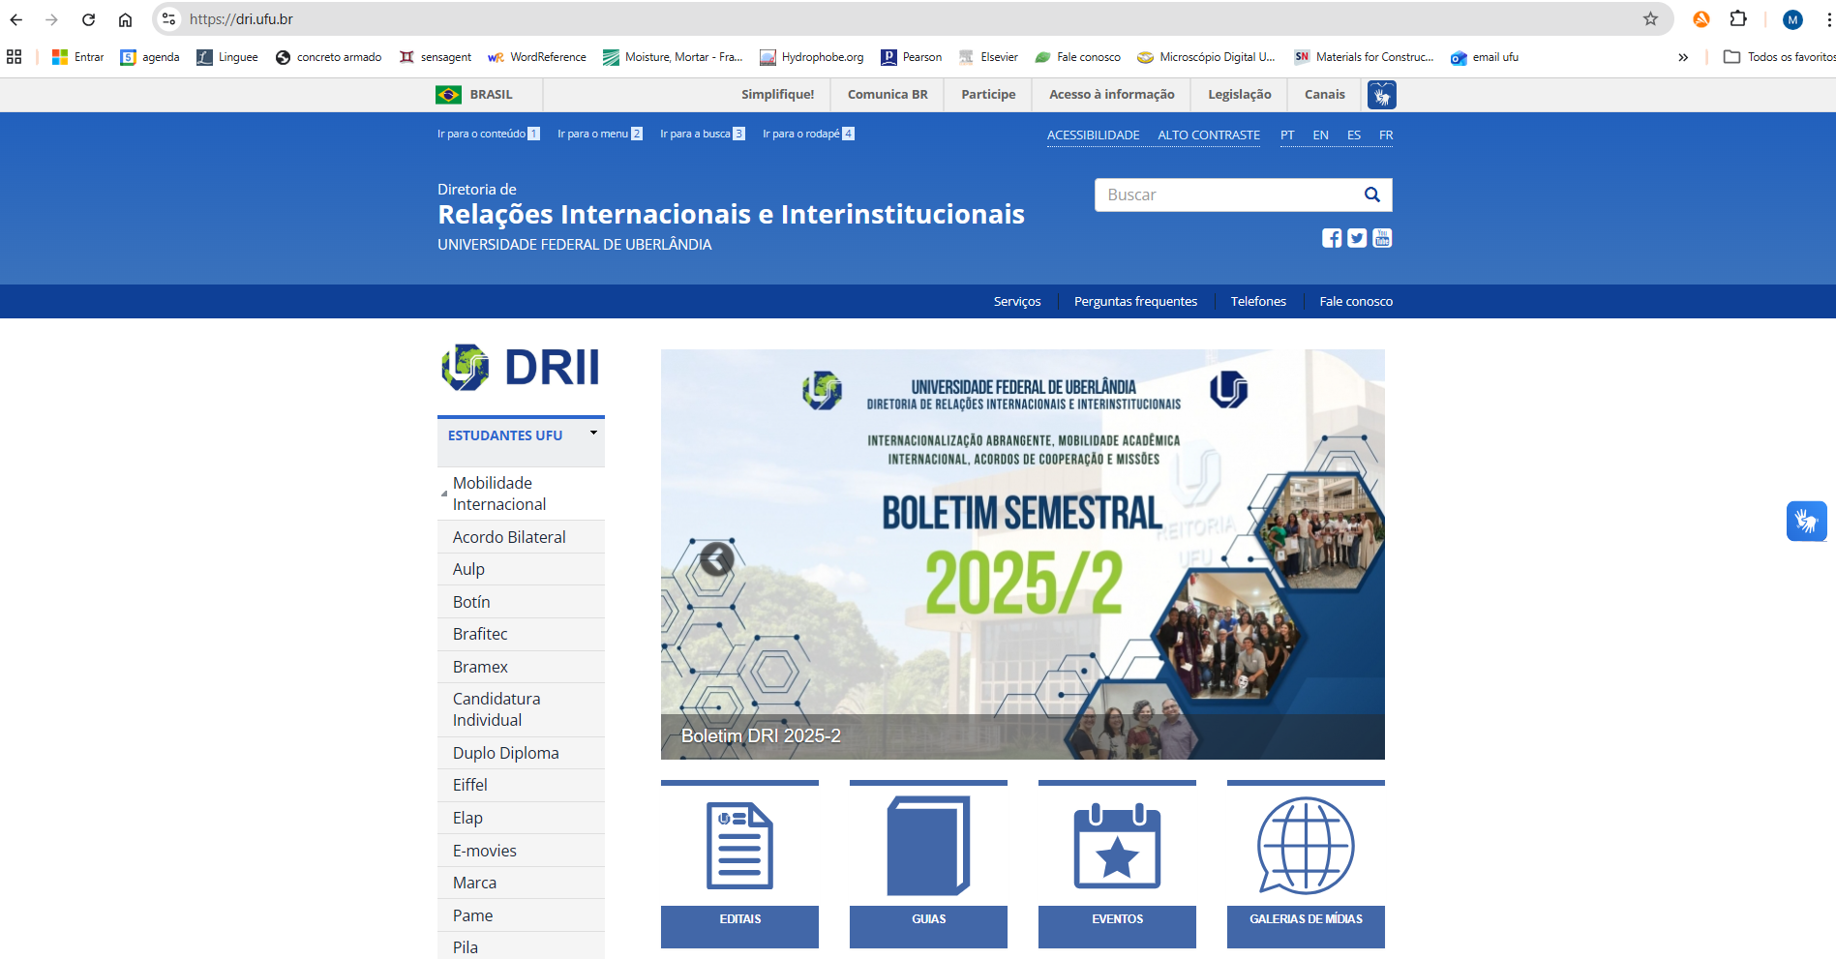
Get to know our website
dri.ufu.br

Slide 26
Thank you
Contact : international@ufu.br

