Slide 1
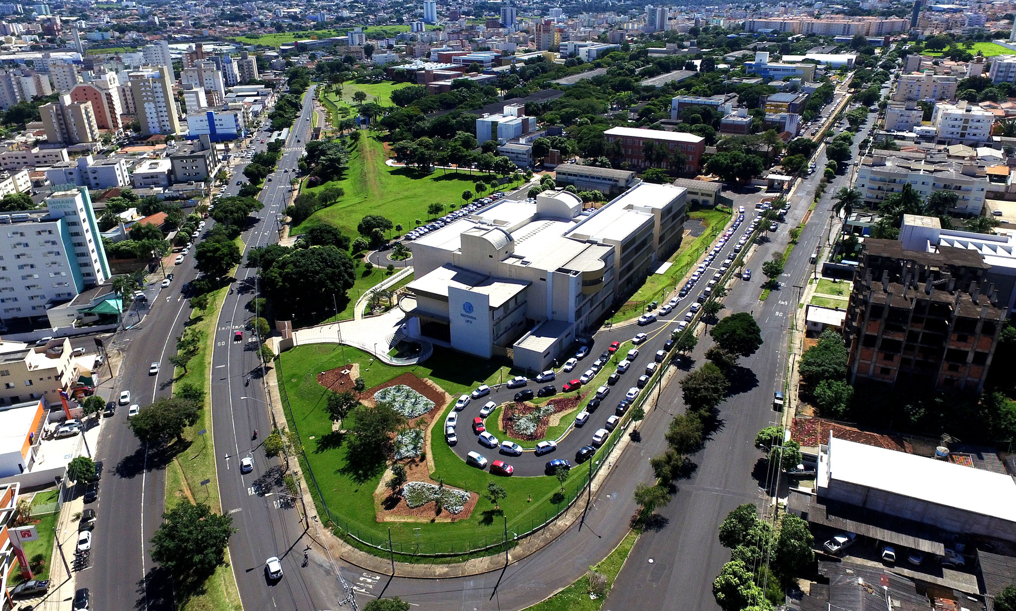

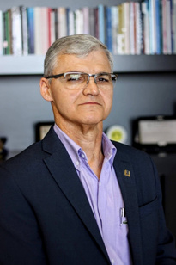

WELCOME TO UFU
RECTOR
Prof. Dr. Carlos Henrique de Carvalho
VICE -RECTOR
Profª. Dra. Catarina Machado Azeredo

Slide 2
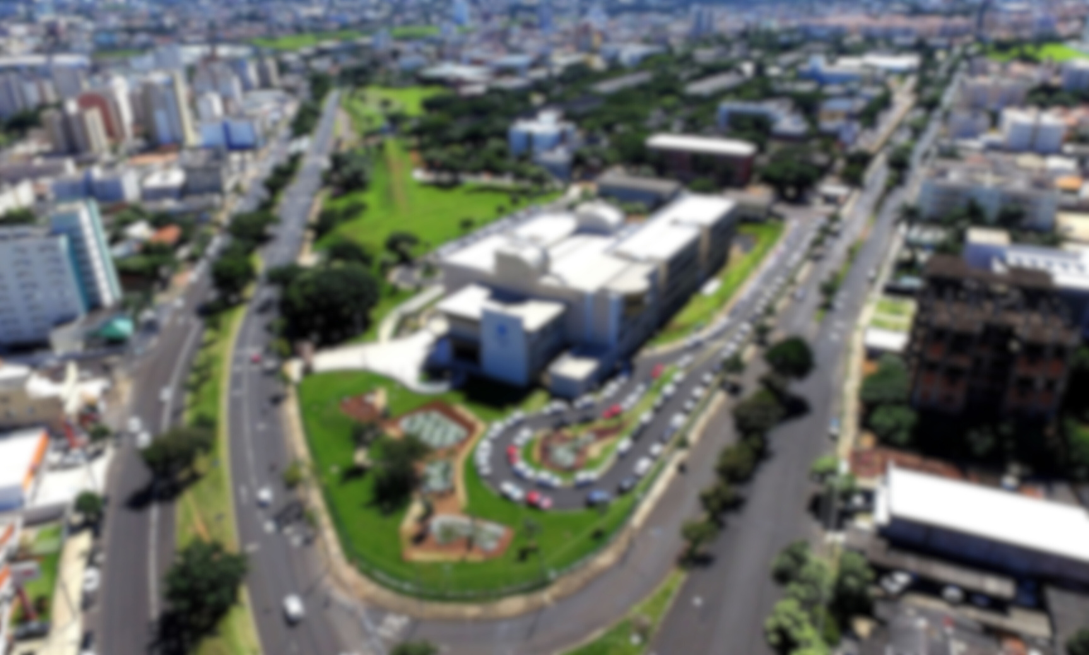

About UFU
Universidade Federal de Uberlândia (UFU) is one of the public, tuition- free Brazilian universities and is funded by the Ministry of Education. Since its founding in 1969, the university has been acquiring growing importance in the Brazilian education context.
UFU has always built up several traditional international relations by signing international cooperation agreements and supporting international mobility opportunities.
UFU is named after the city where most of its campi are located: Uberlância

Slide 3

Get to know Uberlândia
https://www.youtube.com/watch?v=mLvM_WXJk0I

Slide 4
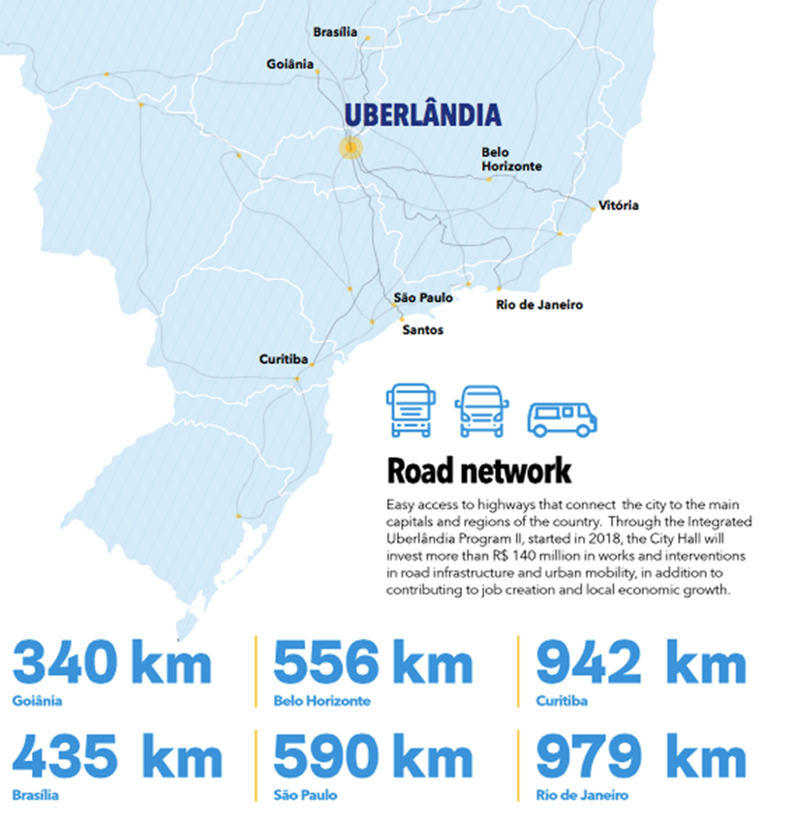

Slide 5
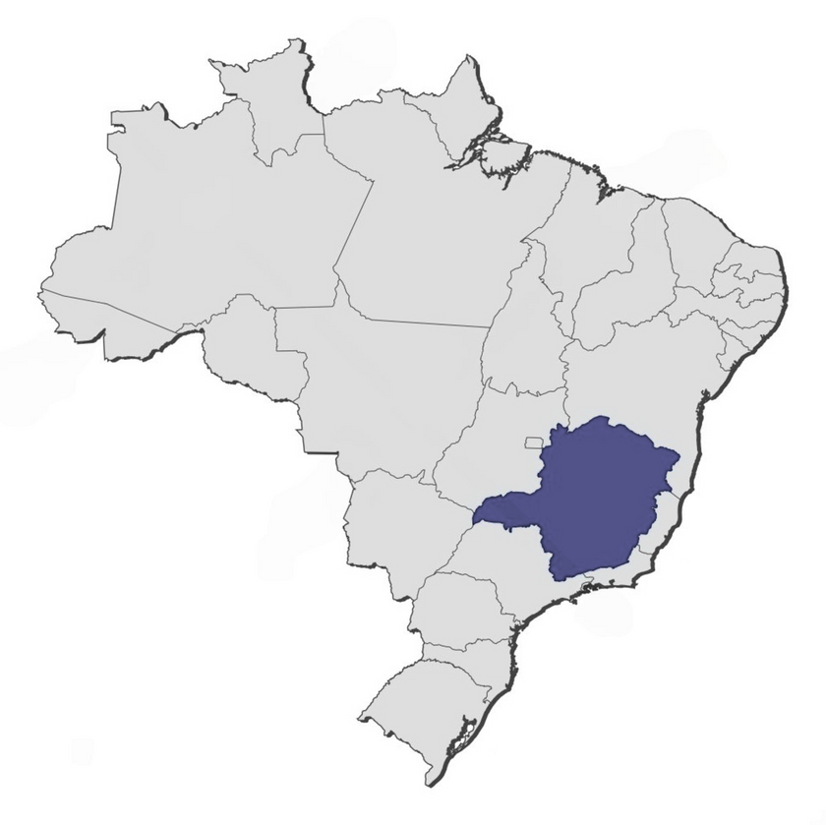




Our campi
Educação Física
Glória
Santa Mônica
UBERLÂNDIA
Umuarama
Monte Carmelo
Patos de Minas
Pontal

Slide 6

Open-air Facilities
Glória
(685 hectares)
Capim Branco
(373 hectares)
Água Limpa
(670 hectares)
Reserva Ecológica do Panga
(+400 hectares)

Slide 7
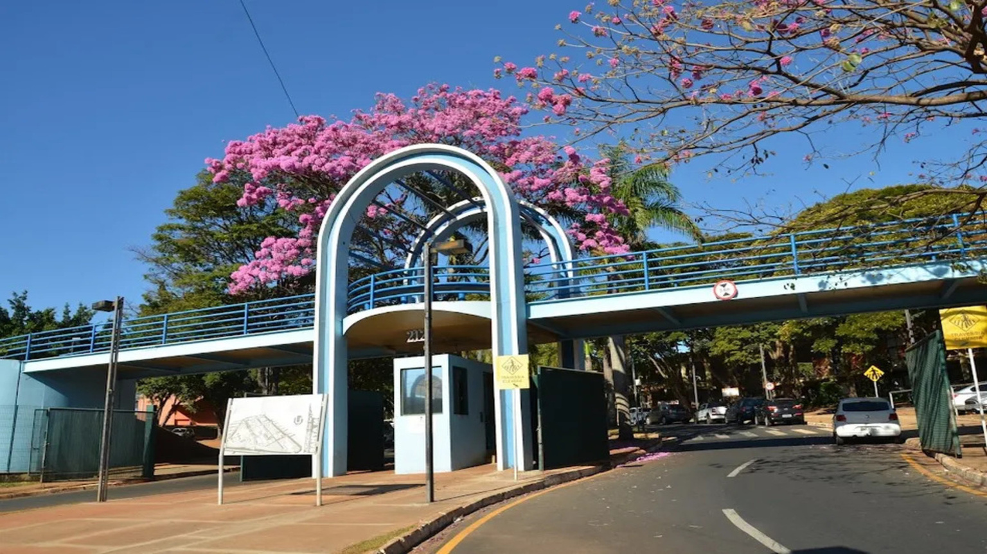
Get to know our institution

Slide 8

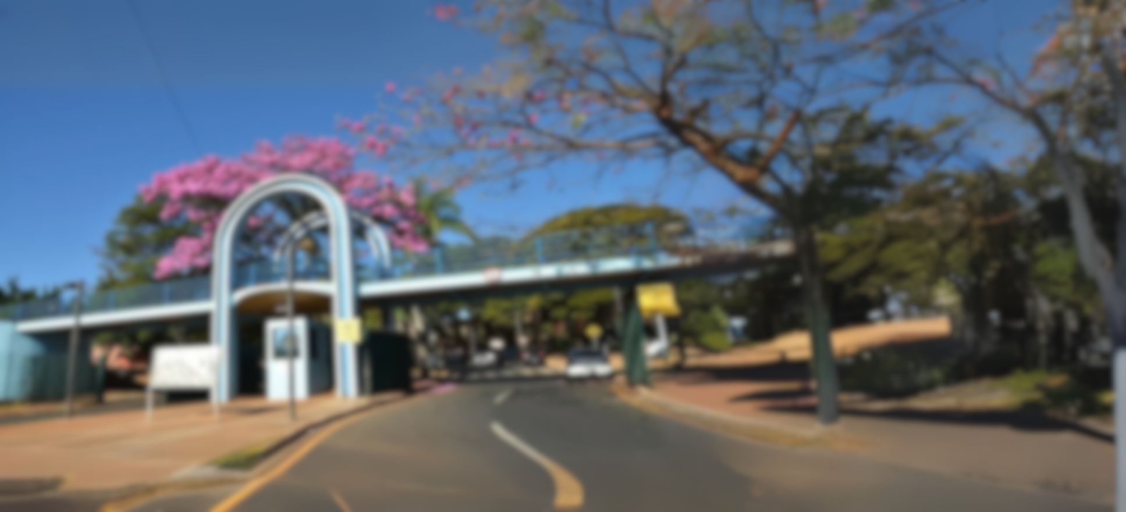






Our institutional numbers
+35k
+28k
+2k
+3k
+1k
+35.000 people
+28.000 enrolled students
+ 1.000
scholarships
+2.000 professors
+3.000 staff

Slide 9
Get to know UFU
https://www.youtube.com/watch?v=0sSN29KHzY4

Slide 10
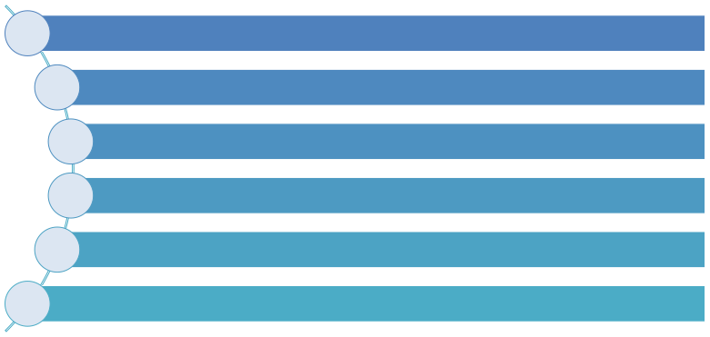






Our institution
97 undergraduate degree programs
32 PhD degrees
42 academic Master’s degrees
11 professional Master’s degrees
44 specialization courses
+50 opportunities for distance education

Slide 11





Distance Education
20 distance education programs
5 undergraduate degree courses
6 post-graduated specialization courses
1 outreach and extension courses
8 refresher courses
Moodle as a learning platform

Slide 12


Additional Numbers
5 University Restaurants
Over 90% hold PHds
3 university hospitals
1 TV Station
1 FM Radio Station
30 Tons of recyclable waste donated to NGOs
9 libraries
6 Sports Centers

Slide 13
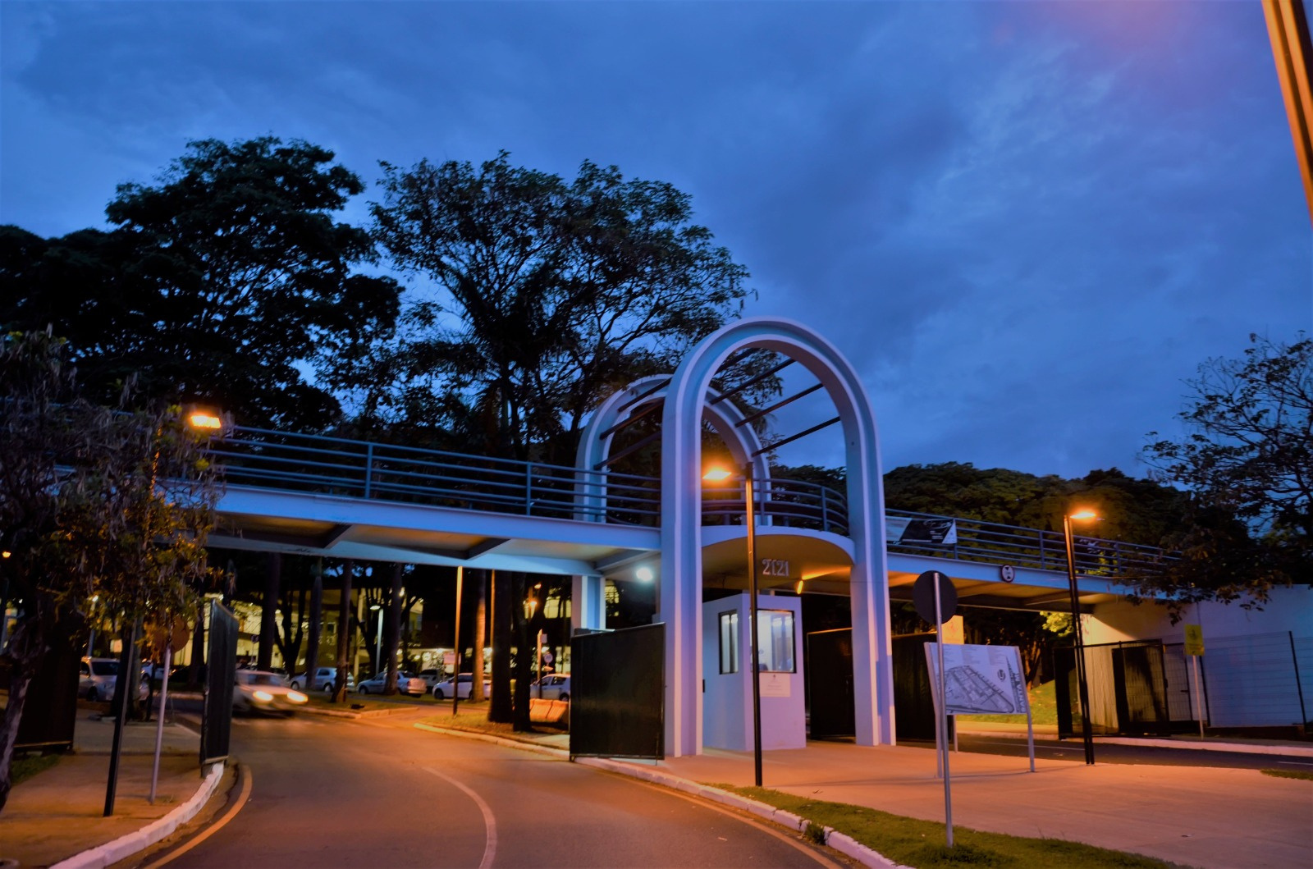
Get to know our international affairs office

Slide 14
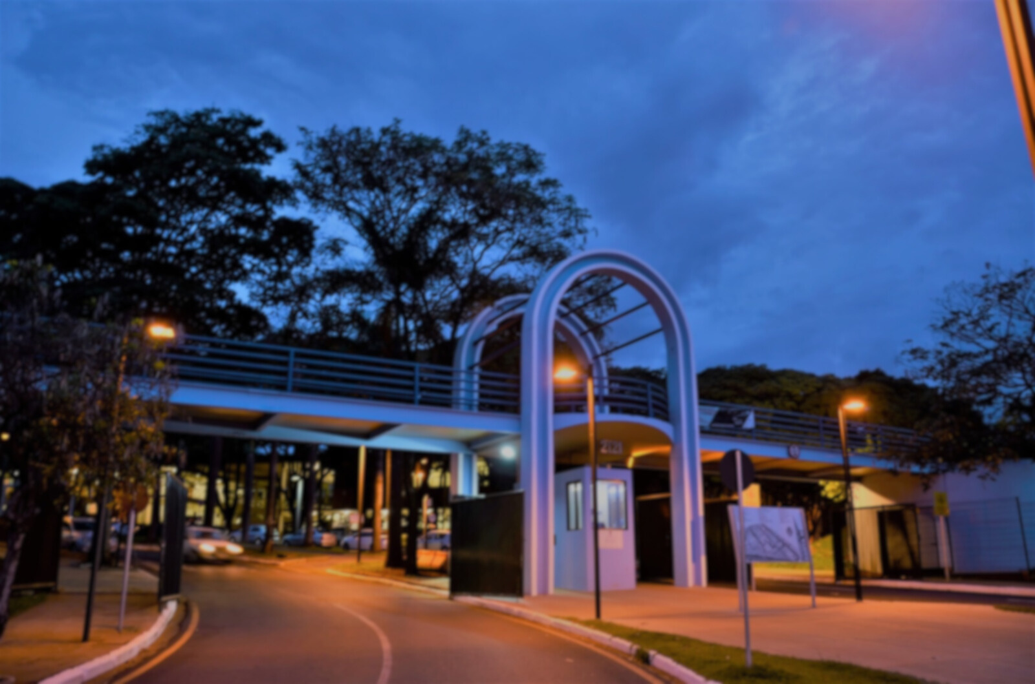


Our International numbers
+2k
+25
+180
8
11
+2.000 international mobility students
25 international professors
+180 partner
universities
8 international programs
11 dual degree options

Slide 15
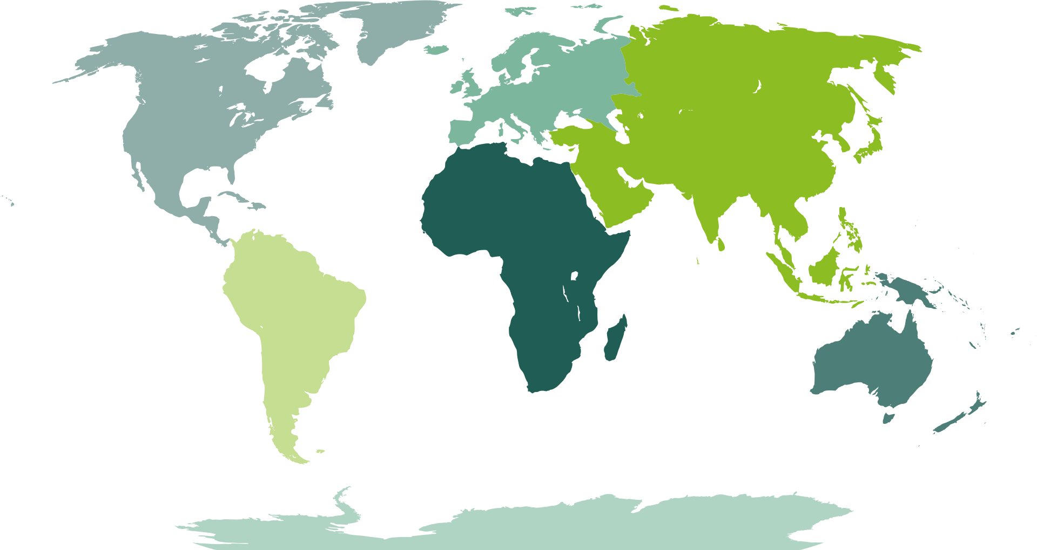
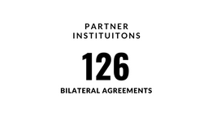


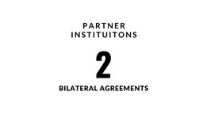
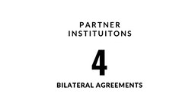
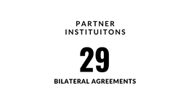
Our bilateral agreement numbers
By continent

Slide 16















International Associations and Networks
FAUBAI Promotes the integration and training of managers, seminars, workshops, regional, national, and international meetings.
The World Association of French-speaking Higher Education and Research Institutions (AUF) brings together more than 1000 universities and institutions across all continents in about 120 countries.
The Association of Portuguese Language Universities (AULP) is an organization that brings together higher education institutions from Portuguese-speaking countries around the world.
The German-Brazilian strategic partnership focuses on expanding cooperation in areas like energy, environment, climate, science, economy, trade, defence, labor, social affairs, and human rights, both bilaterally and multilaterally, including within the United Nations.
The Franco-Brazilian Institute of Business Administration is an associative structure aimed at consolidating university and economic relations between France and Brazil, focusing on both students and professors, in terms of education and research in business management.
A reflective and action-oriented forum of over 350 members from Higher Education Institutions (HEIs), research centers and national, regional, and international associations.
The International Association of Universities, is a membership-based organization that serves the global higher education community through knowledge analysis and trends, publications and portals, advisory services, peer learning, events, and global advocacy.

Slide 17
How can we internationaly collaborate
Signing of MoU (Memorandum of Understanding)
Co-supervisions (Cotutelle Programs)
Mobility of students, staff, researchers, and professors
Specific Cooperation Agreement
Double Degrees

Slide 18

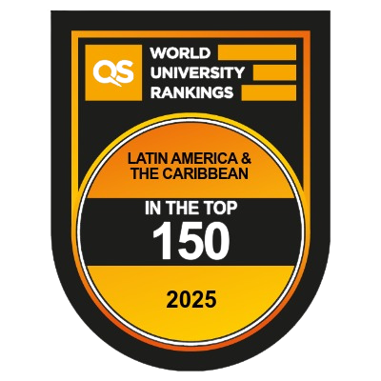

UFU at rankings

Slide 19
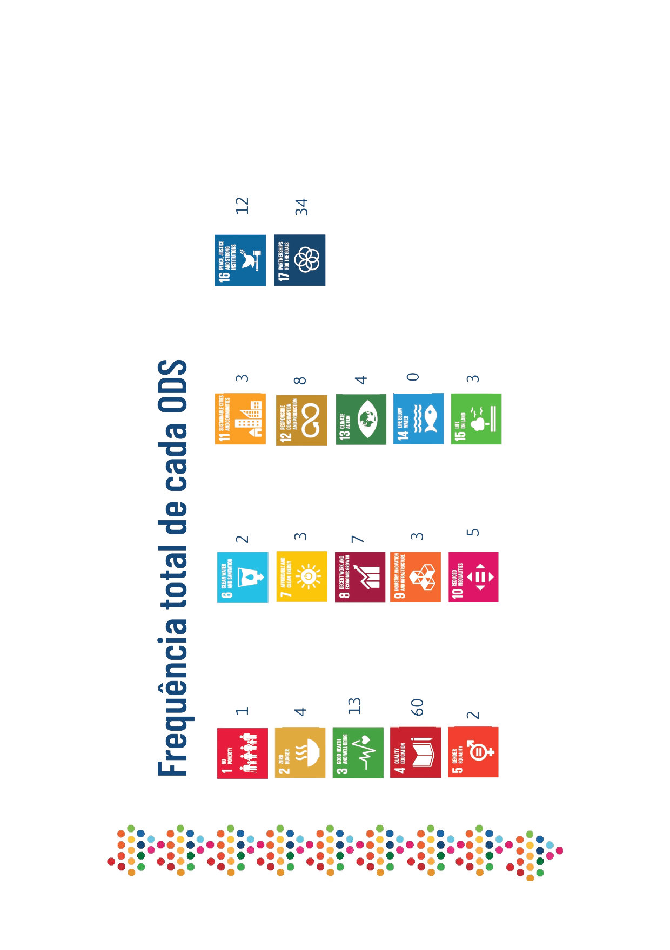

SDG progress report

Slide 20




Get to know some of our projects
The Propulsion and Aerospace Technology Team (EPTA) is an extension project of the Federal University of Uberlândia (UFU), dedicated to the development of experimental rockets and the promotion of model rocketry in Brazil.
WinGs aims to encourage girls to engage in Science, Technology, Engineering, and Mathematics (STEM). By promoting hands-on and educational activities, the project seeks to break social and cultural barriers that limit female participation in these fields.
The global winner of the "Best Use of Technology" award at the NASA Space Apps Challenge, the 42 Quake Heroes aims to accurately detect the onset of seismic events on Mars and the Moon using ground velocity data. They utilized a deep neural network (DNN) model based on the U-Net architecture, a widely used deep learning model initially designed for image segmentation tasks.
Tucano Aerodesign is the aerodesign team from the Federal University of Uberlândia (UFU), dedicated to developing and building scaled aircraft for engineering competition challenges.

Slide 21
Get to know our website
https://dri.ufu.br

Slide 22
Thank you
Contact : international@ufu.br

