Slide 1





Network for Globally Relevant and Socially Responsible Science

Slide 2
Universidade Federal de Uberlândia/UFU (Coordinating HEI) – Southeast Region
Universidade Federal do Pará/UFPA – North Region
Universidade Federal de Catalão/UFCAT – Central-West Region
Universidade Federal do Triângulo Mineiro/UFTM – Southeast Region
Universidade Federal do Cariri/UFCA – Northeast Region
Universidade Estadual do Paraná/UNESPAR – South Region

Slide 3
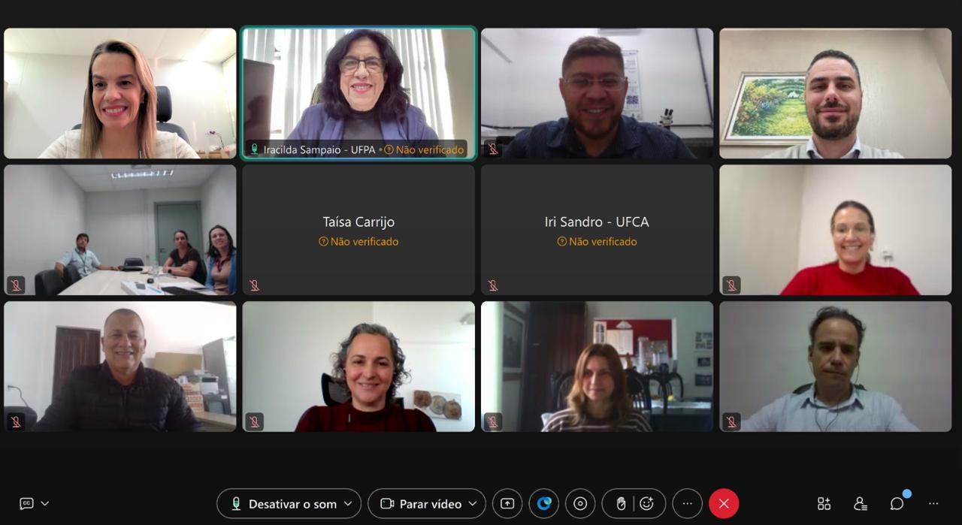
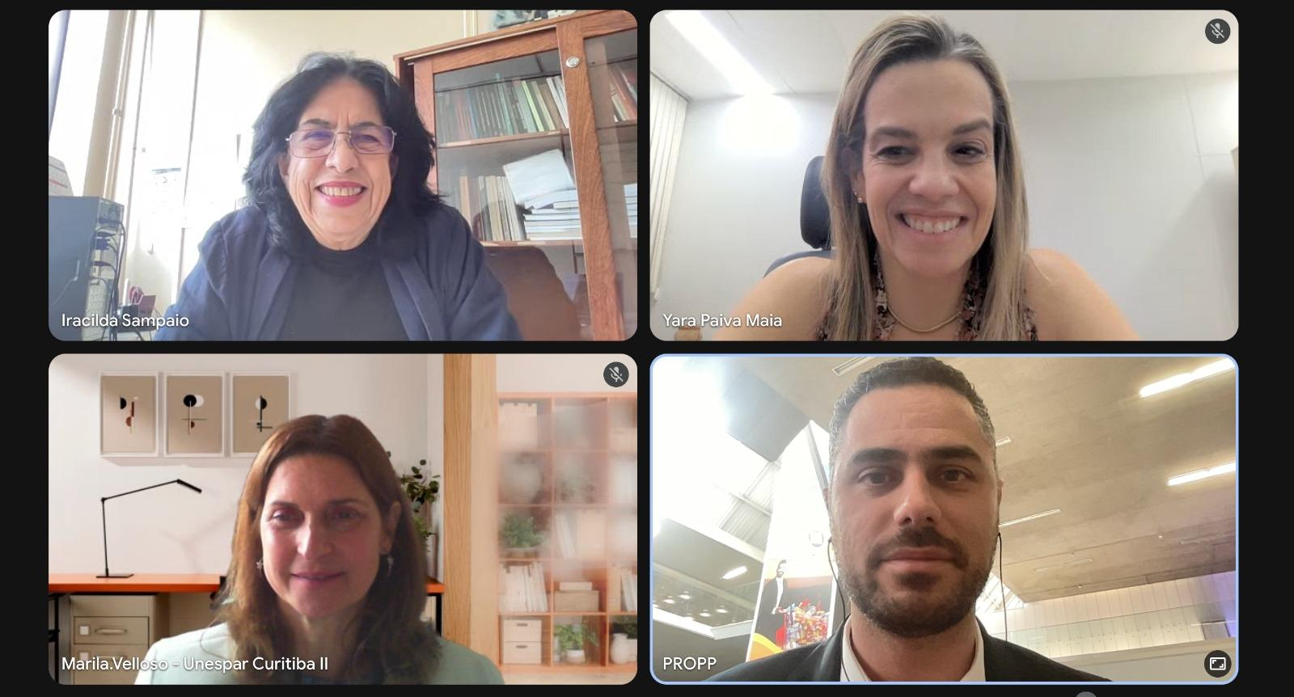
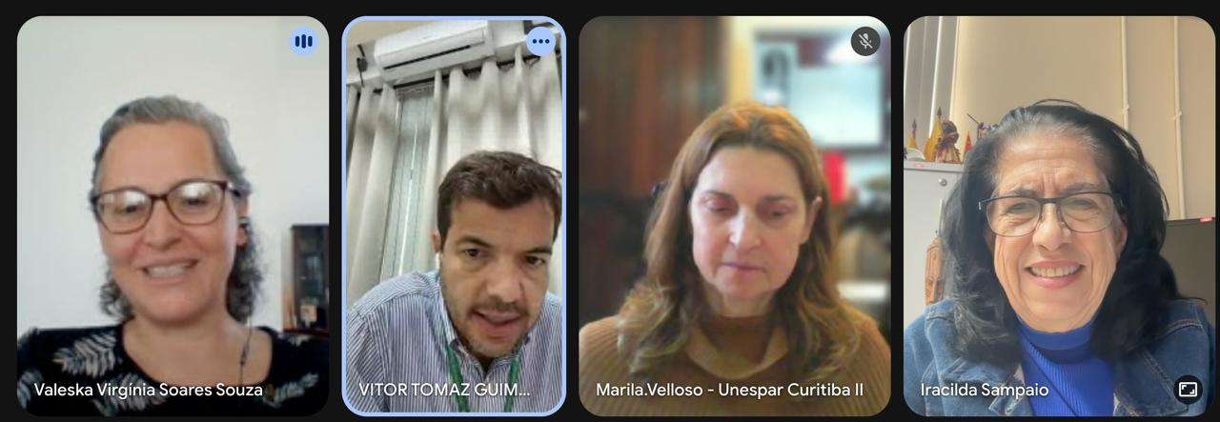
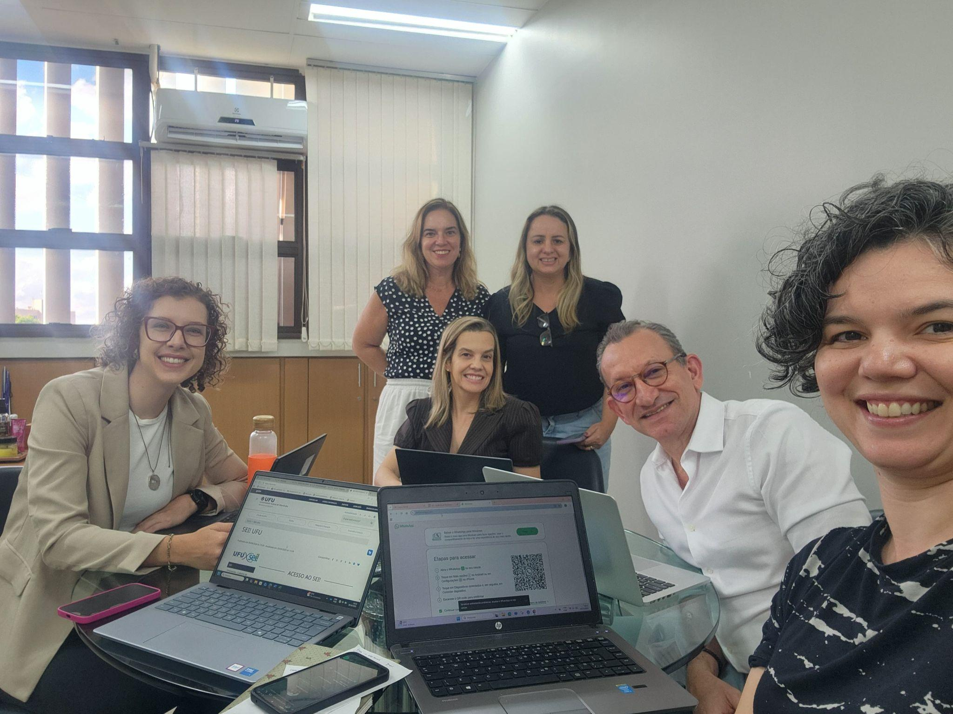
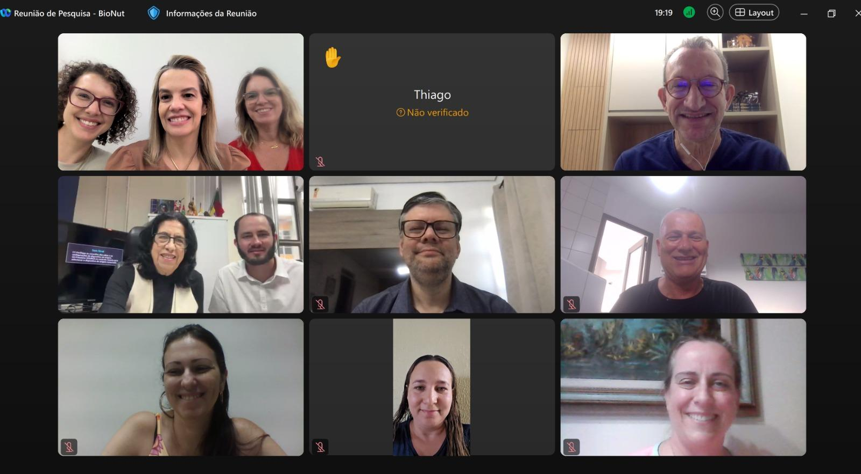
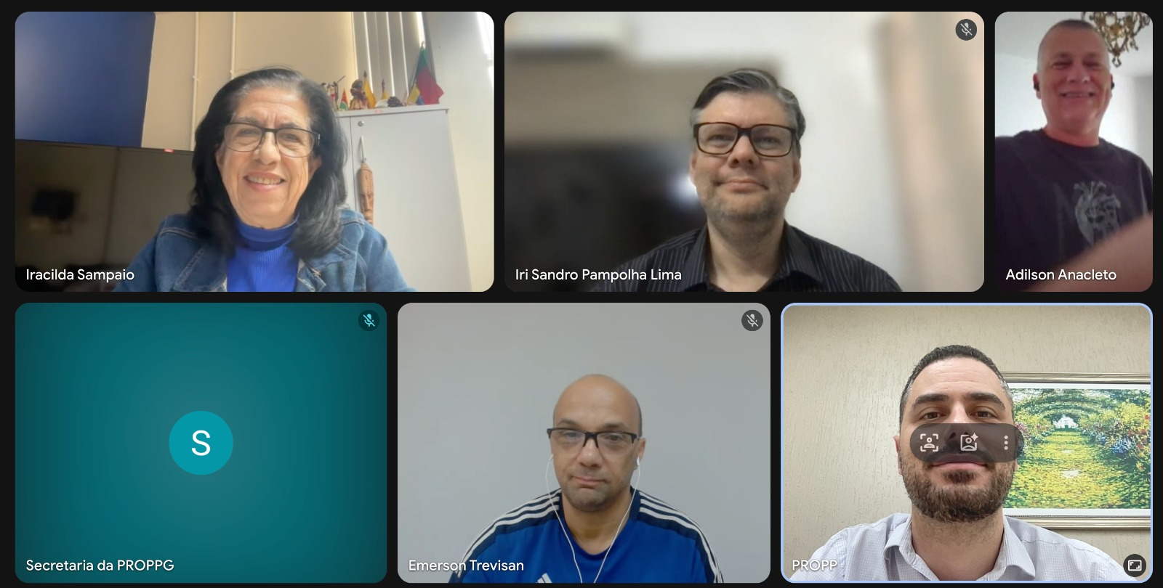
Alignment Meetings _ Network Building

Slide 4
Our Work
Thematic Areas and Strategic Alignment
Four key themes aligned with the Sustainable Development Goals (SDGs)
01
Agriculture, Sustainability, Energy, Climate Resilience, and Conservation of Vulnerable Biomes
02
Digital Transformation, Artificial Intelligence, Innovative Processes and Materials
Goal
Goal
Implement solutions for food and energy security, climate mitigation, and the preservation of the Amazon, Cerrado, Atlantic Forest, and Caatinga biomes
Drive industrial digitization, the development of emerging technologies, and new high-impact materials
SDG 2
SDG 7
SDG 12
SDG 13
SDG 8
SDG 9
SDG 11
SDG 17
03
Governance, Human Rights, Culture, Equitable Societies, and Socioeconomic Development
04
Health, Biotechnology, Converging Technologies, and the Promotion of Social Equity
Goal
Goal
Ensure the strengthening of institutional management, social inclusion, and the promotion of ancestral cultures and indigenous peoples
Promote public health and technological sovereignty through applied biotechnology
SDG 3
SDG 5
SDG 9
SDG 10
SDG 16
SDG 1
SDG 4
SDG 5
SDG 10
SDG 11
SDG 16

Slide 5
Implementation
Action Plan: Strategies and Initiatives
Six key pillars for implementing the network
International Mobility
Global Curriculum
Governance and Capacity Building
Key Actions
Key Actions
Key Actions
Promoting “Out” Mobility (Departure of Researchers))
Courses offered in foreign languages
Training sessions and workshops for leaders
“In” Mobility (Attracting Foreign Researchers)
Activities to familiarize students with Brazilian culture
Training for internationalization teams
Impact: Knowledge exchange and internationalization of the curriculum
Impact: Educating global professionals with a multicultural identity
Research training and graduate studies
Impact: Institutional strengthening and professionalization
Ambassador Program
Shared Infrastructure
Scientific Dissemination
Key Actions
Key Actions
Engaging alumni as ambassadors for the network
Establishment of an equipment-sharing network
Key Actions
Expansion of the international network of contacts
Sharing of research infrastructure among higher education institutions
Active communication of internationalization initiatives
Impact: Expansion of the network's global influence
Impact: Resource optimization and democratization of access
Annual follow-up seminars
Impact: Visibility and transparency of actions

Slide 6
Strategy
Internationalization and the Reduction of Asymmetries
Five Key Strategies for a Stronger and More Equitable Network
Leadership and Support
Collaborative Governance
Inclusion and Diversity
Utilizing UFU’s expertise (formerly CAPES PrInt and current BRICS NU) to support member institutions in establishing international centers and developing strategic plans
Establishment of the Network’s Internationalization Forum for the exchange of best practices and management
Implementation of affirmative action policies in international mobility, ensuring equitable access
Democratic and participatory decision-making
Prioritizing historically marginalized groups
Exchange of best practices among all universities
Equitable Distribution
Continuing education
Criteria of proportionality and regional focus in the allocation of resources (grants and study abroad programs) to strengthen institutions with limited international engagement
Courses in management, languages, and scientific writing are offered to technical and academic staff at all higher education institutions in the network
Gradual reduction of regional disparities
Ongoing skills development
Key Aim
Scope
Beneficiaries
Reducing Disparities
Equitable Internationalization
All HEIs in the Network

